Slide 1
Infectious Disease Syndemics
Kenneth H. Mayer, MD
NIH HIV Co-Morbidities Workshop
September 19, 2019

Slide 2
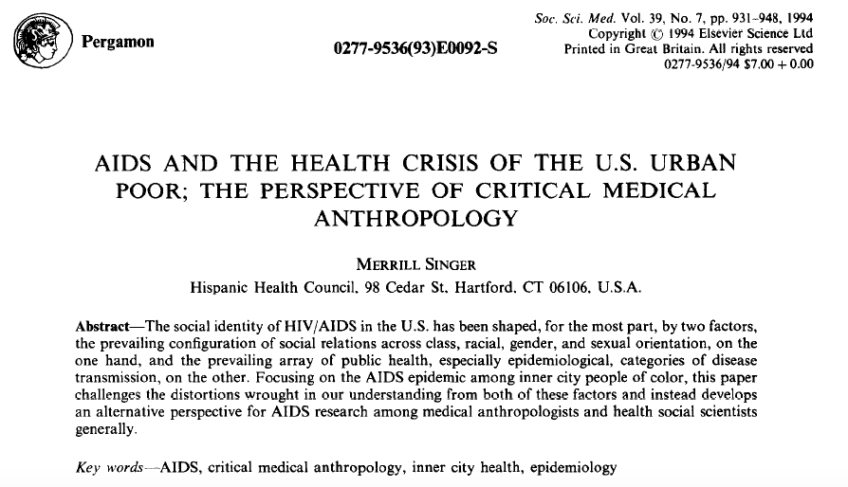
Epidemiological Synergy
Interrelationships between Human Immunodeficiency Virus Infection
And Other Sexually Transmitted Diseases
JUDITH N. WASSERHEIT, MD, MPH
From the Sexually Transmitted Diseases Branch,
National Institute of Allergy and Infectious Diseases,
National Institutes of Health, Bethesda, Maryland
Sex Transm Dis. 1992 Mar-Apr;19(2):61-77
Notes:
Pergamon 0277-9536(93)W0092-S Soc. Sci. Med. Vol. 39, No. 7, pp 931-948, 1994. Copyright 1994 Elsevier Science Ltd, Printed in Great Britain. All rights reserved.
AIDS and the Health Crisis of the U.S. Urban Poor; The Perspective of Critical Medical Anthropology, Merrill Singer, Hispanic Health Council, 98 Cedar St., Hartford, CT 06106, U.S.A.
Abstract – The social identity of HIV/AIDS in the U.S. has been shaped, for the most part, by two factors, the prevailing configuration of social relations across class, racial, gender, and sexual orientation, on the one hand, and the prevailing array of public health, especially epidemiological, categories of disease transmission, on the other. Focusing on the AIDS epidemic among inner city people of color, this paper challenges the distortions wrought in our understanding from both of these factors and instead develops an alternative perspective for AIDS research among medical anthropologists and health social scientists generally.
Key words – AIDS, critical medical anthropology, inner city health, epidemiology

Slide 3
Syndemics are more than Co-Infections
Two or more diseases cluster in a population
Biological, psychological, or and/social interactions exist between these clustering diseases
Structural and social factors precipitate this clustering of diseases

Slide 4
Infectious Disease Syndemics
Biological synergism
-STI and HIV ↑ efficiency of bilateral transmission
-HIV and TB ↑ acquisition and progression risk of each other
HIV ↑ HCV replication, disease progression
Social/Structural synergism
-Poverty, malnutrition, gender inequality, homo/transphobia ↑
risk of being exposed to HIV and other ID pathogens
Behavioral synergism
-Condomless sex or sharing works will co-transmit
HIV and STI or viral hepatitis
-Depression and substance use in response to social
stigma ↑ acquisition risks and disease progression due to
suboptimal engagement in care

Slide 5
WHO estimates 357 million new cases of four curable STIs in 15-49 year-olds in 2012
> 1 million new cases of STI / day
Curable STIs: chlamydia, gonorrhea, syphilis, trichomoniasis
Source: WHO. Global incidence and prevalence of selected curable sexually transmitted infections - 2012.

Slide 6
HIV is highly co-prevalent among patients presenting with STI syndromes in South Africa, 2014-2016
STI syndrome | N = | HIV co-infected | Per cent HIV positive
Genital Ulcer Disease | 363 | 208 | 57.3%
Vaginal Discharge | 742 | 350 | 47.2%
Male urethral discharge | 784 | 211 | 26.6%
There was a significant association between HIV seropositivity and all STI syndromes (p<0.001).
Source: Ranmini Kularatne, Centre for HIV & STIs, NICD. Aetiological Surveillance of Sexually Transmitted Infection Syndromes at Sentinel Sites: Germs-SA 2014-2016. The Communicable Diseases Surveillance Bulletin, Volume 15. Issue 3 – November 2017. http://www.nicd.ac.za/index.php/publications/communicable-diseases-surveillance-bulletin/

Slide 7
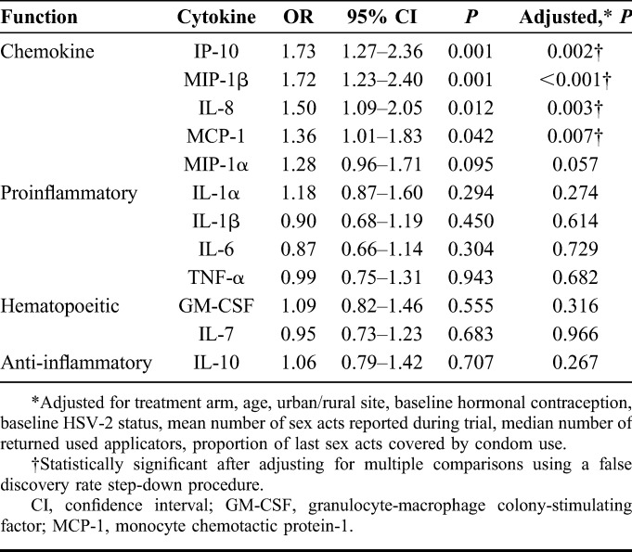
STI-HIV Epidemiological and Biological Synergy
Katz et al. Sex Trans Dis, 2016.
Liebenberg L et al, JAIDS, 2017
Notes:
Let’s switch gears to look at STI infection among HIV-negative men and what that means for future HIV infection.
In an STD clinic population in Seattle & King County, more than 20% of individuals with a rectal GC infection acquired HIV over 5 years of follow-up. Those with early syphilis were also highly likely to acquire HIV infection over the follow-up period. These data again emphasize the overlap of sexual networks that facilitate rectal GC and syphilis transmission and those networks that facilitate HIV transmission.

Slide 8
HIV and STI Interactions: Pre-HAART
Biology (inflammation/ulceration)
Behavior (condomless sex, ↑ partners)
STI
HIV
Epidemiology (risky partners, core group)
Immune
suppression

Slide 9
HIV and STI Interactions: After U=U and PrEP
Biology (inflammation/ulceration)
X
PrEP
Behavior (condomless sex, ↑partners)
STI
HIV
x
U=U & PrEP
Epidemiology (risky partners, core group)
U=U
X
Immune
suppression

Slide 10
Infectious Disease and Behavioral Health Syndemics: Depression and HIV/STIs among MSM in Lesotho
527 MSM completed structured survey instrument, biologic testing for HIV and Syphilis
Defined positive depression screen as a PHQ-9 score of 10 or more
Outcome variable | Adjusted Odds Ratio | 95% Confidence Interval
Laboratory test result
Positive for syphilis | 2.75* | 1.07, 7.08
Positive for HIV | 1.58 | 0.85, 2.94
Self-report
Diagnosed with any STI, past 12 months | 2.04* | 1.02, 4.06
Diagnosed with HIV, ever | 1.27 | 0.61, 2.63
Sources: Stahlman, Baral, et al. Depression and Social Stigma among MSM in Lesotho: Implications for HIV and Sexually Transmitted Infection Prevention. Forthcoming

Slide 11
HIV-TB Syndemic
1.2 million out of 10.4 million annual TB cases occur among PLHIV
Out of 1.8 million TB deaths annually, about 400,000 among PLHIV
Out of 1.1 million HIV deaths annually, 400,000 due to TB
Autopsy study in South Africa found that 69% of deaths with unknown cause in PLHIV on ART were due to TB
TB upregulates HIV replication, ↑ immunodeficiency
HIV transforms TB clinical presentation, diagnosis, and management

Slide 12
TB-HIV Interactions
Active TB disease:
Smear microscopy has lower utility in PLHIV
More lower lung lobe presentations on CXR
Considerable rates of subclinical disease
More extrapulmonary disease and severe forms of TB
Rapid spread of TB (including MDR/XDR) in hospitals
↑ rates of recurrent TB disease after treatment
Latent TB infection:
TST and IGRA miss a lot of latent TB in PLHIV
TB re-infection when TB prophylaxis stopped
All fueled by poverty, malnutrition, substance use

Slide 13
Diabetes, undernutrition, migration and indigenous communities: tuberculosis in Chiapas, Mexico.
Poorest Mexican state, with a high presence of indigenous population
Review of 5508 new adult TB patients diagnosed between 2010 and 2014
Most prevalent comorbidities were diabetes mellitus (19.1%) and undernutrition (14.4%).
Unfavourable TB outcomes were more prevalent among the TB patients who were recent, or malnutrished, with HIV or older age but not DM.
Our study in Chiapas illustrates the challenges of other regions worldwide where social (e.g. indigenous origin, poverty, migration) and host factors (DM, undernutrition, HIV, older age) are associated with TB.
Rashak HA, Epidemiol Infect. 2019

Slide 14
Hepatitis C: A Global Health Problem
170-200 Million (M) Carriers Worldwide
Far East Asia
60 M
Western
Europe
5 M
Eastern
Europe
10 M
United States
3-4 M
Southeast Asia
30-35 M
Americas
12-15 M
Africa
30-40 M
Australia
0.2 M
World Health Organization. Weekly epidemiological record. 1999;74:421-428.
Notes:
Hepatitis C: A Global Health Problem
According to CDC estimates, approximately 3-4 million people in the US are currently infected with the hepatitis C virus (see map). There are, however, a few distinct geographic regions where infection is especially common. In Egypt, for example, HCV infection occurs in 10% to 30% of the general population. Likewise, the prevalence of infection is greater than 10% in certain parts of Asia and high rates of infection have been found in certain geographic regions of Japan, Taiwan, and Italy. In such areas, HCV infection is generally more prevalent among persons over the age of 40 and uncommon under the age of 20. This cohort effect suggests that transmission probably occurred through a practice that has been discontinued, such as traditional folk remedies or reuse of needles for injection. In developing countries, nosocomial transmission is most likely the principal route of HCV infection. Evidence from Egypt, Romania, and other nations, before economic transition, point to various percutaneous practices performed in the context of traditional and nontraditional medical care.
The incidence of acute hepatitis C in the US has decreased during the last decade, from approximately 180,000 cases per year to approximately 30,000 to 50,000 cases per year.
References
Cohen J. The scientific challenge of hepatitis C. Science. 1999;285(5424):26-27.
Alter MJ. Epidemiology of Hepatitis C. Hepatology. 1997;26(suppl 1):62S-65S.
World Health Organization. Weekly epidemiological report. 1999;74:421-428. Available at: http://www.who.int/wer/pdf/1999/wer7449.pdf. Accessed February 19, 2003.

Slide 15
Hepatitis C: United States
3.7 million infected in U.S. (1.8% of population)
People who inject drugs: 52-90%
PLHIV: 9-40%; Incarcerated PLHIV: 50%
MSM: 4-8%
25,000-35,000 new infections per year
60% associated with injection drug use (IDU)
A leading cause of cirrhosis and liver cancer, more likely with HIV-HCV co-infection
Most common reason for liver transplantation
8,000-10,000 deaths from HCV annually, projected to triple in next decade
CDC. MMWR. 1998; 47(No. RR-19):1-39.
NIH Consensus Development Conference Panel Statement Management of Hepatitis C, 2002

Slide 16
Scott County, Indiana: Syndemic Case Study (Peters et al, NEJM, 2016)
Opioid epidemic
↑ in rural/peri-urban, economically depleted communities
Fueled by pill mills, replaced by access to cheap injectable heroin
Exacerbated by lack of access to sterile syringes
Social marginalization and punitive policies regarding PWID fuel similar epidemics globally

Slide 17
Other HIV-Infectious Disease Syndemics
Other causes of viral hepatitis, e.g. Hep B, are more likely to remain chronic and cause cirrhosis and HCC in the setting of HIV co-infection
Viral STI syndemics are consequential
-HSV-2 ↑ susceptibility to HIV, which leads to
more frequent HSV-2 recurrences and shedding
-HPV-related neoplasia more common with HIV co-infection
Parasitic infections, e.g. schistosomiasis, upregulate HIV replication, which ↑ parasite burden and disease course
All of these other infections are affected by similar social, structural factors, and behavioral responses that drive HIV

Slide 18
Conclusions
HIV-related co-infections are common b/c of similar transmission routes and syndemic factors
HIV interacts with other infectious agents in multiple ways, by:
-↑ susceptibility and/or ↑ infectiousness of each other
-Altering the natural history and/or response to therapy
It is impossible to address HIV co-infections without understanding and addressing their interactions with other syndemic conditions, which may affect: -Exposures (e.g. poverty, crowding ↑ TB) -Risk taking (e.g. stigma/depression and sex/drug behavior) -Health-related behavior (e.g. racism →medical mistrust)

Slide 19
Thanks to:
Rick Altice
Stef Baral
Myron Cohen
Emily Mendenhall
Tonia Poteat
Ramnath Subbaraman
www.thefenwayinstitute.org
NIAID, NIMH, NIDA, NICHD, CDC, HRSA, Mass DPH, Gilead, ViiV, MAC AIDS Foundation

