Slide 1
SYNDEMIcs: An Introduction
HIV-associated Comorbidities, Co-Infections, and Complications Workshop
National Institutes of Health
Emily Mendenhall, PhD, MPH
Provost’s Distinguished Associate Professor
Edmund A. Walsh School of Foreign Service
Georgetown University

Slide 2
What are syndemics?
“Syn” – “Demic”
SYNergies among multiple factors
Cluster of two or more epiDEMICS

Slide 3
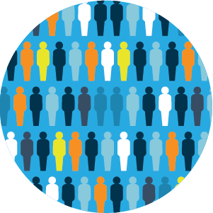
DEMOS
Epidemic – greater than expected frequency of diseases across a POPULATION
Pandemic – an epidemic that spreads across multiple POPULATIONS
Endemic – a well-established disease within a POPULATION that remains year after year
Syndemic – a dynamic relationship involving two or more epidemics and the social factors that precipitate their interaction within a POPULATION
Syndemics are related to EPIDEMICS
(never with pandemics) – they are locally driven

Slide 4
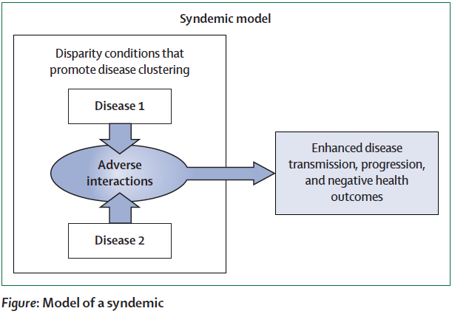
What makes a syndemic?
Two or more diseases cluster within a population
Biological, psychological, or social interactions exist between these clustering diseases
Structural and social factors precipitate this clustering of diseases

Slide 5
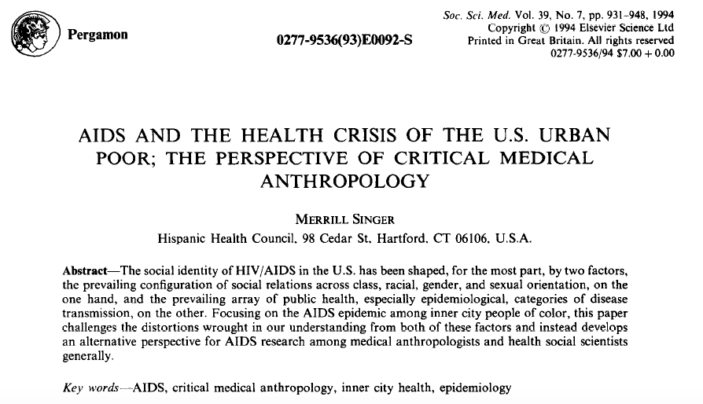
Original Definition
When adverse social conditions, such as poverty and oppressive social relationships, stress a population, weaken its natural defenses, and expose it to a cluster of interacting diseases (Singer 1994, 1996).

Slide 6
The SAVA Syndemic
Structural violence
Negative social and health
consequences
Early Life Experiences
Substance
Abuse
AIDS
Violence
Family and social networks

Slide 7
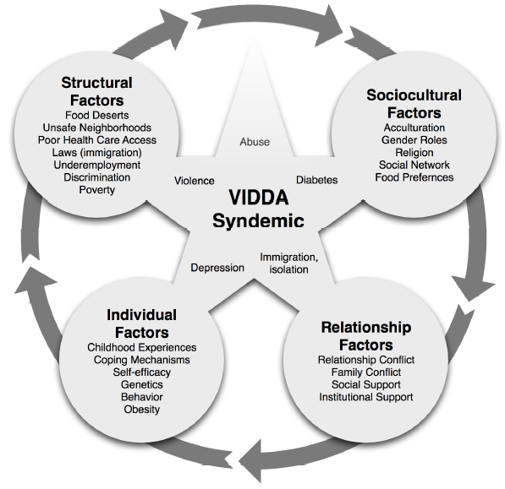
The VIDDA Syndemic

Slide 8
A double burden
Diabetes Afflicts Low Income populations globally
80% of people with diabetes live in the Global South
A socioeconomic reversal of diabetes parallels globalization
Depression and poverty are strongly correlated
Escalation of diabetes among lower income groups shifts diabetes affliction because of:
Higher burden of social stress throughout life
Interface with depression
Interface with chronic infections, including HIV and TB
Unreliable access to routine, quality, and affordable care

Slide 9
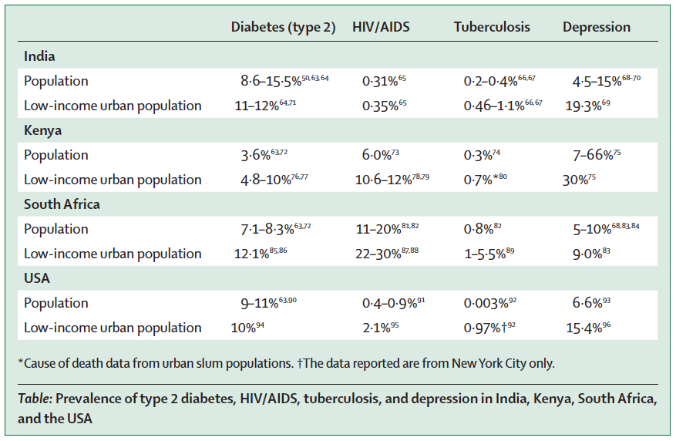
Mendenhall, et al. 2017

Slide 10
From the Introduction:
“the trauma of forced relocation and fragmented social worlds cannot be removed from this story, because real biological and pathological pathways of trauma and chronic stress lead to diabetes, from epigenetics to psychophysiology.”

Slide 11
Esther

Slide 12
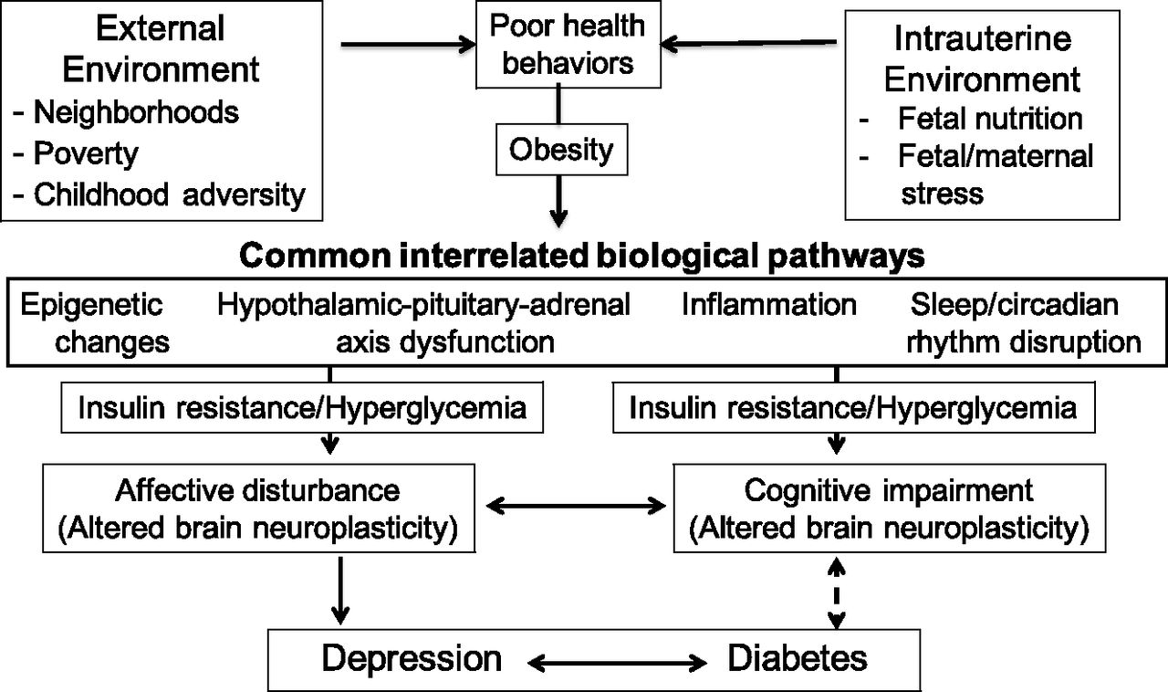
Interactions:
biological, behavioral, psychological, social
Holt et al 2014

Slide 13
Why are diabetes + Infections syndemic?
As diabetes emerges within context of crisis, displacement, and hunger, the condition will converge and interact with other common infections in those contexts, such as malaria and tuberculosis.
CONTEXT

Slide 14
Why do syndemics matter?
Changing the way we think about disease
Recognizing diseases rarely exist in isolation
Identifying how and what social, political, economic, and ecological factors drive poor health
Determining how co-occurring diseases, medications, social dynamics, clinical barriers make people sicker
Understanding the most effective clinical and community-based interventions to mitigate syndemic interactions
Recognizing social policy as key health interventions
Emphasizing need for people-centered care

Slide 15
A Transdisciplinary Agenda
Syndemics shift how we think about disease
Change how we talk about co-occurrence
Put context at the center of how we understand disease emergence, experience, and intervention
Cultivate a comprehensive view of how syndemics emerge, converge, interact, and change through time.
Shift how we think about studying disease: work from ethnography to epidemiology to ethnography
Take seriously the role of biological, psychological, and social interactions in quantitative analyses

Slide 16
Thank you!

Slide 17
What are syndemics not?
Pandemic
Non-localized
Uniform across contexts
“Global”

Slide 18
Syndemics Scholarship has…
Theorized the complexities of what syndemics are, especially in relation to social and medical conditions concurrent to HIV, e.g., (Singer, 1994, 1996, 2009; Singer & Clair, 2003; Stall et al 2003)
Considered theoretically how syndemics may have emerged historically and clearly applying an ecological lens (Singer, 2009)
Translated syndemic thinking to global health and clinical medicine (Mendenhall, 2017; Singer et al., 2017; Mendenhall, et al., 2017; Willen, et al,. 2017; Tsai, et al., 2017; ).
Reconsidered the efficacy of current quantitative approaches to syndemic analyses (Stall et al., 2015; Tsai, 2018; Tsai & Burns, 2015)

