Slide 1

Implementation
Science Research

Slide 2
Implementation Science Working Group
Chairs:
Stefan Baral, MD – Associate Professor, Johns Hopkins University, School of Public Health
Michael Mugavero, MD – Professor, University of Alabama, Birmingham
Members:
Margaret Czarnogorski, MD – Heath, Innovation and Implementation Science, ViiV Healthcare
Mari-Lynn Drainoni, PhD – Professor, Boston University, School of Medicine
Carey Farquhar, MD/MPH – Professor, University of Washington
Elvin Geng, MD/MPH – Professor, Washington University, School of Medicine
Matthew Golden, MD/MPH – Professor, University of Washington
Christian Grov, PhD – Professor, City University of New York, School of Public Health and Health Policy
Lisa Hightow-Weidman, MD/MPH – Professor, University of North Carolina, Chapel Hill
Lisa Metsch, PhD – Professor, Columbia University
Sharmistha Mishra, MD/PhD – Assistant Professor, University of Toronto
Denis Nash, PhD/MPH – Professor, City University of New York
Wynne Norton, PhD – Program Director, National Cancer Institute
Izukanji Sikazwe, MD/MPH – CEO, Centre for Infectious Disease Research, Zambia
Justin D. Smith, PhD – Associate Professor, Northwestern University, Feinberg School of Medicine
Gail Wyatt, PhD – Professor, University of California, Los Angeles, The Semel Institute

Slide 3
Implementation Science Working Group
NIH Representatives:
Cheryl Boyce, PhD – National Heart, Lung, and Blood Institute (NHLBI)
Dara Blachman-Demner, PhD – Office of Behavioral and Social Sciences Research (OBSSR)
Holly Campbell-Rosen, PhD – National Institute of Mental Health (NIHM)
Helen Cox, MHS – National Heart, Lung, and Blood Institute (NHLBI)
Linda Kupfer, PhD – Fogarty International Center (FIC)
Kathryn Morris, MPH – Office of Behavioral and Social Sciences Research (OBSSR)
Joana Roe, BA – National Institute of Allergy and Infectious Diseases (NIAID)

Slide 4
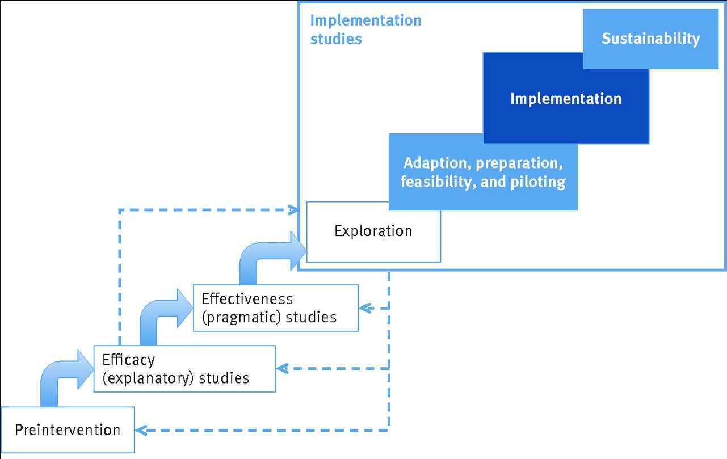
Hilary Pinnock et al. BMJ 2017;356:bmj.i6795

Slide 5
Implementation Science Priority Topics
Introduction to Implementation Science (IS) Research
Synthesizing priority IS HIV co-morbidity research questions
Novel observational and experimental IS research designs
Training opportunities and resources to expand the IS research workforce

Slide 6


Introduction to Implementation Science (IS) Research
Denis Nash, PhD, MPH
City University of New York (CUNY) School of Public Health
CUNY Institute for Implementation Science in Population Health

Slide 7
What is Implementation Science?
Implementation research is “the scientific study of the use of strategies to adopt and integrate evidence-based health interventions into clinical and community settings to improve individual outcomes and benefit population health”.
Implementation science conventionally addresses the gap between healthcare interventions that have been shown to work, and their successful adoption and routine use by service providers and individuals who may benefit from them in ‘real world’ settings.
https://grants.nih.gov/grants/guide/pa-files/PAR-19-274.html
http://cunyisph.org/isph-toolkit/
Proctor et al. 2009.; Glasgow et al, AJE 2012

Slide 8
What is Implementation Science?
After efficacy studies discover interventions yielding better outcomes under controlled conditions, IS focuses on factors and processes or the ‘how and why’ interventions are adopted, implemented & sustained in practice-based settings.
IS is also focused on “the use of strategies to introduce or change evidence-based health interventions within specific settings” (Proctor et al, 2009). This means that strategies are purposefully chosen, and then tested for implementation effectiveness.
IS findings can be used to develop better approaches and guidelines to improve the uptake of successful implementation strategies, and enhance the potential for scale-up of programs across diverse settings with the goal of maximizing their uptake and impact.
  Glasgow et al. note, there is a significant increase in the ‘return on investment’ of healthcare innovations and discoveries by optimizing intervention uptake, implementation, engagement, and scale-up
https://grants.nih.gov/grants/guide/pa-files/PAR-19-274.html
http://cunyisph.org/isph-toolkit/
Proctor et al. 2009.; Glasgow et al, AJE 2012

Slide 9
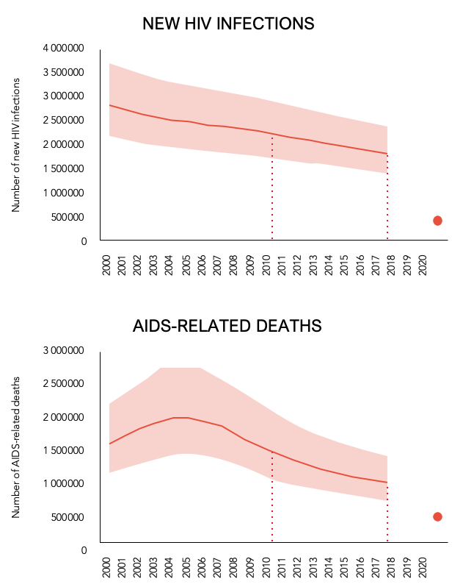
% Starting ART CD4<100
1.8M
Target
940K
90-90-90 progress among 38M PLWH:
2018: 79-78-86
Target
Slide courtesy of N Ford, WHO and UNAIDS
Notes:
This slide has an animation….
This slide shows the tremendous progress made improving ART uptake and coverage, with an estimated 19.5 million people on ART by the end of 2016. This has driven a substantial decline in the number of deaths and incidence.
But these declines are beginning to slow and we will not meet the 2020 UNAIDS milestones any time soon. (Click for animation) This is arguably in part because a substantial number of individuals are diagnosed and initiating ART too late, often several years after HIV infection occurred and with advanced HIV disease

Slide 10
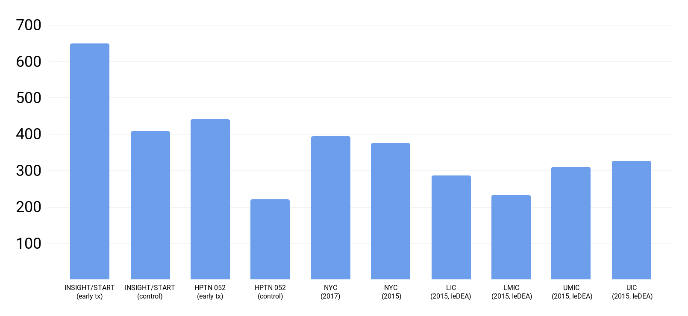

Median CD4 count at ART initiation in landmark controlled trials (left side of figure), and at diagnosis or ART initiation in the real world (right side of figure)
Achieving early diagnosis and ART initiation relative to seroconversion is a challenge globally.
650
→
Real world
←
Controlled trials
2013 WHO
ART guideline
500 cells/µL**
408
442
385
375
Median CD4 count (cells/µL)
2010 WHO
ART guideline
350 cells/µL*
287
311
327
221
234
CD4 at ART initiation
CD4 at
diagnosis
CD4 at ART initiation
*A pre-treatment CD4 count of 350 cells/µL reflects 2.8-3.4 years since seroconversion, on average.
**A pre-treatment CD4 count of 500 cells/µL reflects 1-2 years since seroconversion, on average.
Only 25% initiate ART with CD4>500 globally and <50% with CD4>350
Source: D Nash and M Robertson; Current HIV/AIDS Reports; 2019
Notes:
Diagnosing and treating HIV as soon as possible following seroconversion is a fundamental goal of the public health response and EtHE initiatives everywhere. We are not doing well, and this may be in part because we don’t have metrics and targets used to inform and assess the progress of our implementation work.

Slide 11
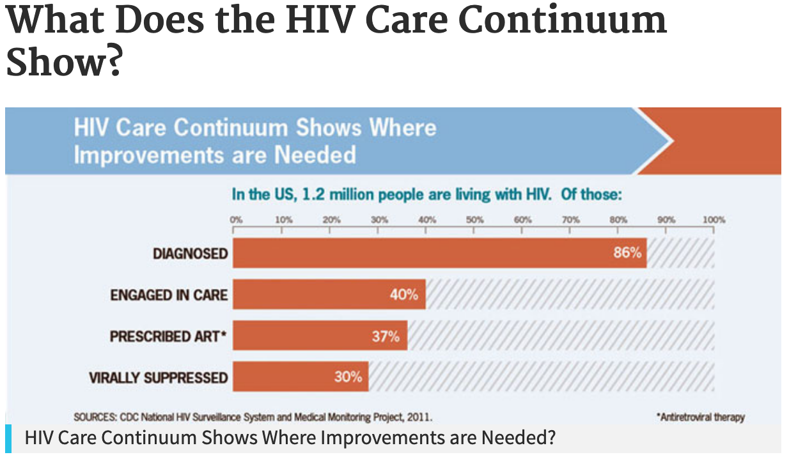
Why we need HIV-related IS Research
HIV-related programmatic scale-up and routine service delivery offer many opportunities to improve HIV-related health outcomes through better implementation and integration of evidence-based interventions
    They also offer opportunities to improve other health outcomes (e.g., HIV-associated co-morbidities) among those receiving HIV-related services.
HIV.gov

Slide 12
IS Opportunities vis a vis HIV-associated co-morbidities: The Big Picture
For a given HIV-associated co-morbidity, what can be learned from implementation science research that has been conducted outside the HIV setting
In resource-limited settings, what can we learn about screening, diagnosis, and management of HIV-related comorbidities that will be relevant to the care HIV-negative populations?
Implementation science research around screening and management of risk factors for HIV-related comorbidities (e.g., smoking, obesity) could result in prevention and/or earlier detection of several HIV-related comorbidities, reducing their ultimate burden.
Would a better understanding of the preferences of clients/patients/providers with respect to a given evidence-based intervention be useful to better inform the design of strategies to improve their uptake, engagement, and delivery?

Slide 13
J.D. Smith, Ph.D.
Northwestern University Feinberg School of Medicine
Synthesizing priority Implementation Science HIV co-morbidity questions

Slide 14
Current State-of-the-Science
IS has established a corpus of research methodologies to evaluate, test, and understand implementation of evidence-based practices
Shifting from “Can we make it work?” to “How can we best make it work?”
Greater emphasis on optimizing implementation strategies that, alone or in combination, achieve crucial implementation outcomes more expediently, cost-effectively, and acceptably to delivery systems/agents and those PLWH that receive interventions for HIV-related comorbidities

Slide 15
Key Research Questions
What combination of implementation strategies are necessary and sufficient to increase the impact of interventions for HIV-related comorbidities?
Given limited resources in our jurisdiction, what implementation strategies will be most effective when implementing interventions for HIV-related comorbidities at the lowest cost?
How can we learn from our successes and challenges as we roll out interventions for HIV-related comorbidities over time to more expediently achieve implementation?
Can the cost and resources involved in a successful multicomponent implementation strategy package be reduced while maintaining its impact?
How can the field begin to optimize implementation during the development and testing of new interventions for HIV-related comorbidities?

Slide 16
Why these Questions?
With recent scientific advances in both biomedical and behavioral interventions, the challenge is delivering these interventions to the right people, at the right time, in the right place, via the right way, and in the right amount (implementation).
Finite resources exist for implementation that must be used as efficiently as possible to achieve maximum effects
Decision-makers need guidance to make informed selections of interventions and the required strategies to implement them based on evidence that can quantify the budget impact, cost-benefit, and cost-effectiveness

Slide 17
Opportunities
Design implementation trials to either explicitly or at least to better understand implementation optimization.
  adaptive designs (fractional factorial, SMART, MOST)
  dismantling designs
  rollout optimization trials
Begin to synthesize the findings from multiple implementation trials
Design interventions for HIV-related comorbidities with implementation in mind (designing for D&I)
Apply a range of implementation research methodologies for PLWH experiencing comorbidities (e.g., McNulty, Smith, et al. 2019, Ethnicity & Disease)

Slide 18
Novel study designs for implementation research (a sampler)
Elvin Geng, MD MPH
Professor of Medicine
Director, Center for Dissemination and Implementation
Washington University in St Louis

Slide 19
Traditional Clinical Research
Does it work if used? (efficacy)
Does it work better than something else? (comparative efficacy)
Does it work better than something else is a real world (-ish) setting? (comparative effectiveness)
We have methods for these questions…

Slide 20
Implementation Research Questions
How do you get an evidence-based intervention widely used?
  …But answers are contexts–specific – therefore no one answer
How to we optimize use of multiple implementation strategies to get the same EBI used?
                …Too many combinations to empirically compare
How do we optimize use of multiple implementation strategies sequentially?
            …Where treatment must depend on response

Slide 21
External Validity – Clinical Treatments
Target Population (Where you want to infer)
Study population
Effect =3
Effect =3

Slide 22
External Validity – Implementation Strategies
Effect =3
Effect =3
Effect =1
Effect =5

Slide 23
New Science of External Validity?
Transportability
  Population composition and the mechanism in the source population
  +
  Information about how those differ in target population
“Seed and soil”
Judea Pearl and Elias Bareinboim 2011 JSM Proceedings, Miami Beach FL, July 30-August 4, 2011, pp. 157-171. Statistical Science
2014, Vol. 29, No. 4, 579–595

Slide 24
How do we optimize the mix of implementation strategies when there are too many strategies to compare empirically?

Slide 25
Example: Differentiated Service Delivery
Scenario #1
Scenario #2
Responds to A (e.g., MMS)
Responds to A (e.g., MMS)
Responds to B (e.g., CAG)
Responds to B (e.g., CAG)
Comparative effectiveness: B is worse than A
Comparative effectiveness: B is worse than A
Optimization: B contributes significantly to public health impact
Optimization: B does not contribute to public health impact

Slide 26
Can choice experiments play a role in optimization?
Notes:
Once driver of use is preferences
Science of preferences from economics and marketing
We are trying to be happy
Live in a world of constraints – can’t get everything you want
Make trade offs to get what makes us happy
Decisions depend on an individuals preferences
Under certain assumptions, preferences (and trade offs) can be quantified by asking people to make a series of hypothetical choices
Increasingly used in health and global health (Kruk AJPH 2009)

Slide 27
Subgroups detected by latent class analyses: Choice experiment in Zambia (N=247)
85%
15%
Location drives decisions
Three month visit frequency very important
Strongly prefer clinic
Prioritize location
Three month visit frequency favored but much less important
Prefer treatment in community
Eschun Wilson JAIDS 2019

Slide 28
How do we optimize use strategies together sequentially (target treatment to response)?

Slide 29
Implementation strategies
No silver bullets, therefore how to use strategies (sequentially) to optimize use and effects?
Most things in clinical and public health practice (try something and then try something else in those who don’t respond or succeed).
  Can’t do everything at once
Standard research comparison does not answer the question
  “A” better then nothing?
  “A” better than “B”?
We want, how do you use A and B together to get the best outcomes.

Slide 30
Adaptive Strategies to Target Public Health Interventions
  An adaptive, sequential strategy uses multiple interventions or strategies (each of which may have small effects) over time
  “Adaptive” because what is used depend prior response
    Start with less effective but less toxic / less expensive intervention or strategy and then escalate (switch, augment) among those not responding
Minimizes expenditures / toxicities for whom the initial strategy is sufficient (optimizing efficiency)
Intensifies support for those who need additional or alternative help (optimizing effectiveness)

Slide 31
Sequential multiple assignment randomized trials
(Susan Murphy 2011, 2012)
Notes:
Flowchart 1:
Study Population to First stage "prevention" intervention to Assess response to Second stage "treatment" intervention to Measure outcomes
Flowchart 2: Study enrollment goes to:
Routine education and counseling (REC); if Not Retained it then goes to Outreach and/or SMS + Voucher and/or Navigator; if Retained goes to REC
SMS Text Message & REC; if Not Retained it then goes to Outreach and/or SMS + Voucher and/or Navigator; if Retained goes to either Continue SMS or Discontinue SMS
Voucher & REC; if Not Retained it then goes to Outreach and/or SMS + Voucher and/or Navigator; if Retained goes to either Continue Voucher or Discontinue Voucher
Time to lapse in engagement, Time to re-engagement, HIV RNA level, Visit adherence
Source: Susan Murphy, 2011, 2012

Slide 32
Conclusion
Implementation research ask slightly different questions as compared to clinical research
  Different questions raise distinctive challenges
  Distinctive challenges require novel methods
Need to community of HIV researchers to adopt and use those tools (along with theories and frameworks)
Accelerate to end HIV epidemic

Slide 33
Training opportunities and resources to expand the Implementation Science research workforce
Mari-Lynn Drainoni, PhD
Boston University School of Medicine

Slide 34
Implementation Research Training
An HIV-related IS workforce is needed
  Need for IS generalists/methodologists
  Mixed methods training important to understand the “why” of the research-to-practice gap
  IS-trained with content expertise - bring important value
Two priorities:
  Leveraging existing IS training
  Expand IS training to add HIV focus

Slide 35
IS Training Questions & Gaps
  Cannot just “do” IS research without training
What can be easily layered onto current IS generalist training?
What can be easily layered into HIV-related research consortia and activities?
Almost all NIH-sponsored trainings targeted to specific content area – nothing specific to HIV
High demand for & low supply of IS training program
Except for larger NIH-funded training programs to a specific institution, most NIH-funded trainings target only clinician investigators

Slide 36
Training Opportunities
Create an information exchange network or “learning system”
  Registry of funded HIV implementation trials or hybrid studies
Establish a registry of curricula
  Many curricula out there – work with developers to determine if there is HIV-related content
  Integrate implementation science methods into CTSAs
  Push implementation science as a core function of CFARs
  Develop and harmonize online “intro to IS course” (inter-CFAR course)
Integrate IS methods/training days into national HIV meetings
Integrate more explicit HIV components into current implementation science training opportunities

Slide 37
Implementation Research Training Ideas
One size training does not fit all
  General IS training for partnerships vs. in-depth training to do it yourself
Potential examples:
  General training in IS for researchers involved in earlier translational steps of HIV research – form partnerships with implementation researchers
  For effectiveness/large data researchers, how to add IS components to understand my data
  For behavioral scientists/intervention developers, IS mixed methods to use to understand intervention outcomes

