Slide 1
Clinical Research Working Group
Todd Brown, Ann Kurth
Co-Chairs

Slide 2
Our Purview
Purpose: To identify the most important clinical research questions in HIV comorbidities over the next 10 years
Identity: Clinical Trials, Deep Human Phenotyping, Translational/Physiologic Human Studies
Overlap:
Epidemiology -Basic Science
Syndemics - Implementation Science
Notes:
The most common comorbidities vary depending cohort factors such as age and geographic region, ^{5,8,9} but include hypertension, hyperlipidemia, cardiovascular disease, cancers, diabetes, chronic liver disease, kidney disease, decreased bone mineral density and chronic lung diseases, mental health and substance use disorders.^{3,6,7,10-12}

Slide 3
Who We Are
Allison Agwu | Peds/Adult ID
Joyce Anastasi | Symptoms/CAM
Todd Brown | Endocrinology
Ann Kurth | Reproductive Health
Kristina Crothers | Pulmonary
Judith Currier | ID/Cardiology
Kristine Erlandson | ID/Geriatrics
Marcia Holstad | Self-management in HIV & HIV/Aging
Priscilla Hsue | Cardiology
Jules Levin | Community
David Metzger | Substance Use
Lauren Patton | Oral Health
Robert Remien | Psychology
Serena Spudich | Neurology
Lauryn Taylor | Community
Emmanuel Thomas | ID/Liver
Tom Uldrick | Oncology
Notes:
The most common comorbidities vary depending cohort factors such as age and geographic region, ^{5,8,9} but include hypertension, hyperlipidemia, cardiovascular disease, cancers, diabetes, chronic liver disease, kidney disease, decreased bone mineral density and chronic lung diseases, mental health and substance use disorders.^{3,6,7,10-12}

Slide 4
Draft Topics
Comorbidity management in HIV (e.g, CVD, DM, COPD, Cancer): Should it be the same as the general population?
Prevention studies in HIV to reduce comorbidity burden , i.e. tobacco cessation for cancer, Exercise for cardiometabolic risk
Disparities based on sex, age, gender, race, sexual orientation, and race: How to address in clinical trials?
Social determinants of health, Behavioral factors & their impact on Comorbidity Management
Incorporating patient-centered outcomes in clinical trials
Imaging and biomarker outcomes as surrogates in clinical trials
Obesity in PLWH
Comorbidities in PLWH from Pediatrics to Geriatrics: Clinical Trials Across the Lifespan

Slide 5
Priority Topics
Topic 1: Prevention studies in HIV to reduce comorbidity burden, including screening (anal, cervical cancer; tobacco use; cardiometabolic risk; mental health) and interventions, in a secondary prevention framework across the lifespan, including to reduce comorbidity burden in aging populations.
Topic 2: Comorbidity management in HIV (e.g, CVD, DM, COPD, Cancer, Asthma, mental health): Should it be the same as the general population, or tailored? (Cover all relevant key co-morbidities).
Topic 3: Incorporating patient-centered input and outcomes (symptom management including for pain), as well as innovative imaging and biomarker outcomes as surrogates, in clinical trials.
In all of the above topical areas we will address and interweave issues of disparities based on sex, age, race, gender, and sexual orientation

Slide 6
Topic 1: Prevention as Treatment (PasT): Clinical and Translational Studies to Prevent Comorbidities in People with HIV
Clinical Research Working Group
Allison Agwu (lead) + Marcia Holstad + David Metzger + Bob Remien + Lauren Taylor
NIH Comorbidities Conference
September 19, 2019

Slide 7
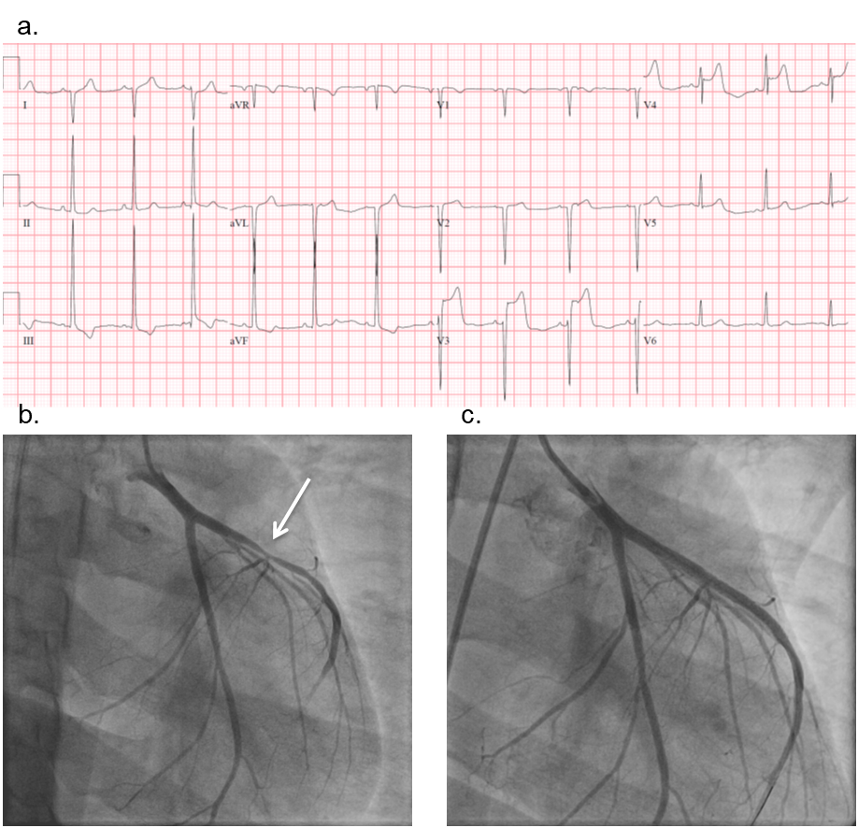
Why do we need to think about prevention?
Life expectancy ↑ with effective ART
Non-HIV associated comorbidities developing in HIV+ Individuals
cardiovascular disease, metabolic dysfunction, organ (e.g,. liver, kidney, neurocognitive, mental health) dysfunction, non-AIDS defining cancers
HIV+ individuals have ↑ risk factors
Modifiable (e.g., tobacco, substance use, poverty, diet)
Non-modifiable risk factors (race/ethnicity, family history) common compounding the risk
Preventative strategies (e.g., aspirin, statins) routinely employed among HIV-; not routinely for HIV+ adults
Impact of inflammation and accelerated aging along the life course from children to elderly
Individuals who acquired HIV in the first decades of life, concern for higher rates of co-morbidities with age
Griffith OFID 2018

Slide 8
What are the remaining key research questions in the area of HIV comorbidity prevention?
1) What are the best ways to screen for, identify, and prevent comorbidities in research and clinical settings for both the United States (US) and resource-limited countries?
2) What are the high priority screening and prevention guidelines (across the age spectrum) that need to incorporate HIV as an additional risk factor?
3) Are there high priority prevention strategies that need to be employed or targeted in individuals with HIV across the age spectrum?
4) Are standard prevention strategies (e.g., diet and exercise) as effective in HIV+ individuals?
5) Are there modeling strategies that can assist in delineating the risk, benefit, and cost-savings implementing screening and prevention strategies among people with HIV?

Slide 9
Panel Members
Group member Affiliation | Expertise/interest
Allison Agwu | Pediatric, adolescent HIV, optimization of care and outcomes; treatment clinical trials, complications
Marcia Holstad | Adherence self-management, HIV positive women, HIV and Aging, motivational interviewing, technology
David Metzger | Psychiatry, HIV prevention
Robert Remien | Mental health, coping & resilience, behavioral & bio-behavioral interventions
Lauryn Taylor | Community engagement, cancer

Slide 10
BRIEF PANEL DISCUSSION

Slide 11
Questions for panelists
What are the most critical research studies needed to address prevention among individuals with HIV? United States? Resource-limited countries?
2) What is the major barrier to research studies addressing prevention strategies for comorbidities among individuals with HIV?

Slide 12
Take home message
Urgent need to evaluate preventive medicine practices to assure that HIV is considered a potential risk factor for ↑ risk of development of comorbidities and if yes, to evaluate best practices for prevention, early screening, detection, and treatment, to optimally prevent or mitigate disease in this population across the life spectrum.
Need clinical research studies and interventions.

Slide 13
Topic 2: Comorbidity Management in HIV: Should it be the same as the general population or tailored?
Kristina Crothers, Kristine Erlandson, Priscilla Hsue, Lauren Patton, and Emmanuel Thomas
for the HIV Action Workshop, Clinical Research Work Group

Slide 14
Increasing prevalence of multimorbidity and polypharmacy in aging PLWH
Multi-morbidity, the concomitant presence of 2 or more comorbid diseases, impacts approximately 25-50% of older PLWH
Treatment of multimorbidity is often accompanied by polypharmacy, or use of 5 or more medications
Excluding ART medications, 25% or more of PLWH experience polypharmacy
Notes:
The most common comorbidities vary depending cohort factors such as age and geographic region, ^{5,8,9} but include hypertension, hyperlipidemia, cardiovascular disease, cancers, diabetes, chronic liver disease, kidney disease, decreased bone mineral density and chronic lung diseases, mental health and substance use disorders.^{3,6,7,10-12}

Slide 15
Potential mechanisms for comorbidities: Are they different in PLWH and what is the role of HIV?
Differences in pathogenesis can confer differential benefits and harms of standard therapies for comorbidities
Chronic inflammation, immune activation and T-cell dysfunction
HIV treatment
Co-infections
Aging and cellular senescence
Differences in social-behavioral factors can also contribute
Social determinants of health, health behaviors, and socioeconomic disparities
Access to care or disparities in care due to gender, race, ethnicity and sexual orientation

Slide 16
Limited data on optimal treatment and management of comorbidities in PLWH
Are standard pharmacologic treatments and management strategies accepted in clinical practice for comorbidities in HIV-uninfected individuals as effective or do they require modification in PLWH?
Favors Standard Treatment
Against Standard Treatment
Efficacy / effectiveness
Availability, approved indications
Lack of evidence on efficacy, effectiveness
Greater potential harms/side effects
Notes:
Most clinical practice guidelines address single diseases, exclude PLWH, and often even older uninfected adults,
and are based on data from clinical trials that exclude those with multimorbidity.

Slide 17
Limited capacity of health care system to care for aging PLWH, particularly with multimorbidity
Fragmentation of care as complexity increases, referrals to subspecialties
Patient safety may be compromised, outcomes worse, health care costs higher
Greater support and payor reimbursement for coordination of care as well as novel health care delivery models are needed
HIV can serve as a model of accelerated aging that can be applied to the general population to inform management of comorbidities and innovative paradigms of care for patients with multimorbidity

Slide 18
Optimizing Treatment, Improving Outcomes and Minimizing Harms
How should clinical practice guidelines and standards of care for different comorbidities be tailored to PLWH, including those with multimorbidity?
How do interventions aimed at decreasing inflammation and immune activation in PLWH impact risk and progression of individual comorbidities as well as multimorbidity?
How should treatment of comorbidities be prioritized amongst PLWH who have multimorbidity? Should frailty and measures of physical function be used to prioritize and tailor therapies?

Slide 19
Discussion

Slide 20
Topic 3: Patient Reported Outcomes and Biomarkers
Definitions
Integral PRO and biomarkers may serve as part of an intervention or be used to guide eligibility criteria, stratification, monitoring, and serve as endpoints.
Integrated PRO and biomarkers may be incorporated to test hypothesis testing, and to support clinical outcomes.
Exploratory PRO and biomarkers may be incorporated for assay development or development of hypotheses

Slide 21
Panel Members

Slide 22
PRO and Biomarker Panel Members
Group member | Expertise/interest
Joyce Anastasi Professor Nursing, NYU | Symptoms/CAM
Judith Currier Professor of Medicine, UCLA | ID/Cardiology
Jules Levin National AIDS Treatment Advocacy Project | Community
Serena Spudich Professor of Neurology | Neurology
Thomas Uldrick Deputy Head, Global Oncology, Fred Hutch | Oncology

Slide 23
Patient Reported Outcomes and Biomarkers

Slide 24
Observational Study
Cancer
Cardiovascular disease
Population living with HIV
(+/-controls)
Co-infection
Lung Disease
Mental Health
Etiologic Agents
Risk Factors
Pathogenic Processes
Metabolic disease
Musculoskelatal
Neurologic Disease

Slide 25
Clinical trial
Subpopulation of Population living with HIV
Primary Outcome
Secondary Outcomes
Controlled
Intervention
(Exposure)
Exploratory Outcome

Slide 26
Questions
What questions about comorbidities in PLWH are best addressed through PRO and biomarkers studies?
How can biomarkers and PRO be used to evaluate the effect of HIV on an aging processes?
What technologies facilitate efficient assessment of existing data as well as new PRO and biomarkers?

