Slide 1
Basic Science of HIV Comorbidities: The Microbiome
Ron Collman, MD - University of Pennsylvania
Dirk Dittmer, PhD - University of North Carolina

Slide 2
The Microbiome
The totality of microbial residents living in concert with the human body, along with their genes, functions, products
Sites
Bacterial
Fungal
Viral
Developing world: Protazoa & chronic colonizing “infections”
Gut
Oral
Respiratory tract
Plasma
Rectum
Vagina
Male genital
Breast milk
Skin

Slide 3
The Microbiome
The totality of microbial residents living in concert with the human body, along with their genes, functions, products
Up to 10x as many bacterial cells in the human body as human cells
Possibly 1000x as many different bacterial genes in the human bacterial microbiome than in the human genome
Up to 1/3 of plasma small molecules are hypothesized to derive from gut microbiome sources
The microbiome is influenced by age, geography, diet, behavior, drugs and many other factors

Slide 4
The Microbiome in Organ System Comorbidities
In inflammatory bowel disease, gut microbial dysbiosis is strongly associated with local gut inflammation.
An increasing number of organ system diseases that are relevant to HIV are associated with gut microbial dysbiosis and/or pathogenic mechanisms, including Cardiovascular, Metabolic syndrome, Neurological disorders, Liver disease
Pathway/mechanisms are thought to be mediated by
  Systemic inflammation
  Metabolomic alterations
  Local interactions (such as in cancer – gut & lung) are implicated as well
In animal models, modulation of the gut microbiome can impact some of these end organ pathologies
However, there is not yet definitive data that altering or targeting the gut microbiome in humans impacts downstream organ systems – many studies ongoing

Slide 5
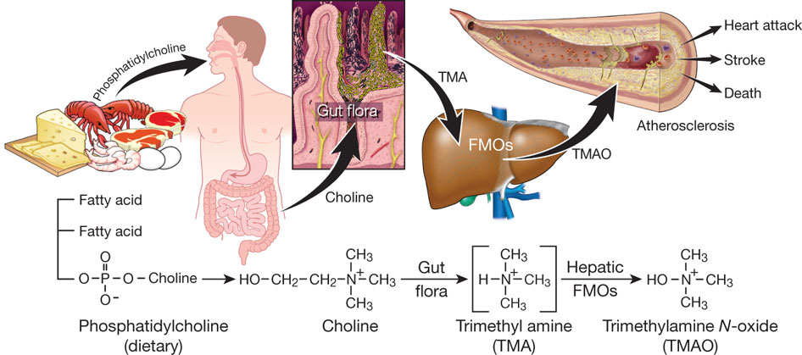
Feasibility
Metabolic pathways of cardiovascular risk
Pro-atherogenic:
Correlated in humans
Causative in murine models
Preventable by gut microbial manipulation or small molecule targeting
Dietary Choline
& Carnitine
Wang & Hazen et al
Gut microbial metabolism to TMA - absorbed to circulation
Regulation of epithelial carcinogenesis
Garrett, Science 2019
Feasibility
Checkpoint inhibitor immunotherapy
efficacy
Lundberg,2018 taconic.com

Slide 6
The Microbiome in HIV: what we know
Gut microbiome is perturbed in HIV infection – both untreated and treated
Gut microbiome is also altered by sexual practice – differs in MSM from MSW
    Both a confounder and potentially mechanistically relevant
Expanded gut and plasma virome is seen in HIV infection and in pathogenic SIV infection
Subtle alterations of respiratory tract microbiome
Microbial translocation from the gut and associated gut barrier injury is one of the mechanisms of inflammation in HIV infection
Inflammation is strongly associated both with immunopathogenesis (ART treated and untreated), and with Comorbidities (Cardiovascular, Metabolic, Liver, Neurological, etc)

Slide 7
Potential areas of microbiome impact in HIV disease
Gut
Oral
Respiratory tract
Plasma
Potential roles in:
Gut barrier function, systemic inflammation, immunopathogenesis
Comorbidities: Cardiovascular, Neurological, Respiratory, Liver, Cancer, Metabolic syndrome
Could be mediated by:
Both systemic and local mechanisms
Via metabolic products, inflammatory mediators
Vagina
Breast milk
Rectum
Male genital
Skin
Potential roles in:
HIV transmission (vaginal, breast milk, male genital, rectal)
Vaccine development (gut)
ART activity (vaginal, gut)

Slide 8
Key question - 1
1. Does the microbiome (bacterial, viral, fungal) play a causal or contributory role in HIV comorbidities?
  • Are microbiome changes that have been identified in HIV infection mainly a consequence of gut epithelial or immune damage, or are they a contributor to or perpetuator of such damage, microbial translocation and/or systemic inflammation and downstream comorbidities including heart, liver, vascular, neurocognitive, pulmonary, cancer, and others?
  • Are changes in the virome (gut, plasma, oral, vaginal) contributors to systemic inflammation and/or end organ comorbidities, or markers of immunological or barrier dysfunction?
  • How do HIV-associated microbiome alterations at mucosal sites beyond the gut (e.g.; lung, oral) affect co-morbidities such as cancer, chronic lung disease, cardiovascular or CNS disease or others?

Slide 9
Key question - 2
2. How do other cofactors interact with HIV infection to affect the microbiome and downstream comorbidities?
  • Does ART itself, geography, diet, smoking, sexual behavior, gender and other factors impact the microbiome and its function in HIV-associated comorbidities?
  • How do co-infections, particularly those that are prevalent in resource-poor areas and may be considered part of the "microbiome" there (e.g.; candida, GI helminths, malaria, TB, viruses) impact comorbidities either directly or via effects on the more conventionally viewed gut microbiome?

Slide 10
Key question - 3
3. What are the mechanisms of host/HIV/microbiome interactions?
  What are the mediators responsible (protein, carbohydrate, small molecule metabolomic, other), and how do microbial products influence the host metabolome, and vice-versa? How does ART impact these pathways?
  Beyond taxonomy, what functional changes to the microbiome are involved in these mechanisms?
  Are new bioinformatic and statistical tools needed to more completely describe these mechanisms and relationship to host gene expression and immune/inflammatory mediators?

Slide 11
Key question - 4
4. If causal or contributory - rather than just a consequence/association - can the microbiome in HIV be manipulated to modify these pathways?
  Via microbiome replacement, selective microbe targeting, microbe-directed small molecule therapeutics or other approaches?
  To be successful, would such approaches need to also target the injured mucosa to achieve sustained impact?

Slide 12
Feasibility & Path Forward
• Given the rapid progress in microbiome-organ function research, a focused effort in the context of HIV can leverage that progress to accelerate discovery regarding HIV comorbidities.
• Incorporating microbiome/virome/ fungome and metabolome measurements into comorbidity-focused HIV clinical trials would provide a platform to advance discovery.
• In general, microbiome research murine models have been extremely valuable, but challenges exist in translation to HIV.
  Nonhuman primates infected with SIV are the best model for HIV pathogenesis, but logistically more challenging and some important differences exist between human and NHP with respect to the microbiome.
  A mix of small animal, human and innovative NHP studies will likely be needed to advance the field, and development of novel approaches that model the interaction between the microbiome and HIV-comorbidies will be necessary.

Slide 13
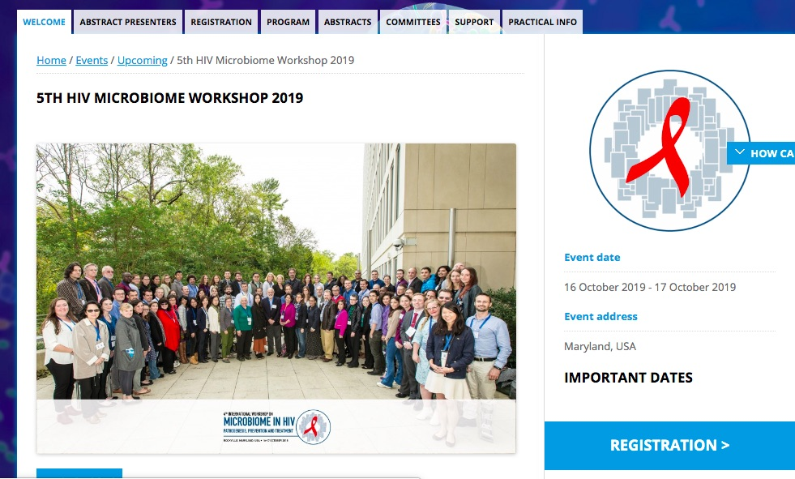
5th International Workshop on Microbiome in HIV Pathogenesis, Prevention and Treatment
October 16 & 17, 2019
Bethesda, MD

