Slide 1
NIH Workshop on HIV-Associated Comorbidities, Coinfections and Complications: Aging and Senescence
Judith Campisi Ph.D.: The Buck Institute for Research on Aging
Cara Wilson M.D.: School of Medicine University of Colorado
Howard Fox M.D., Ph.D.: Pharmacology and Neuroscience UNMC
Beth D. Jamieson Ph.D.: David Geffen School of Medicine at UCLA

Slide 2
Treated HIV infected adults are living near normal lifespans
What about healthspans?
Median age to non-AIDS related death in the pre- and post-HAART era in the MACS
>20 years
49
Pre-HAART
70
1996
< 9 years
66
Post-HAART
75
10
20
30
40
50
60
70
80
Years
HIV+ (SP)
Uninfected (SN)
Wada et al. Am J Epidemiol. 2013

Slide 3
Treated HIV infected adults are at increased risk for earlier onset of morbidities associated with aging
Cardiovascular Disease Liver cancer
Hypertension Anal and cervical cancer
Diabetes Osteoporosis
Frailty Neurocognitive dysfunction
Renal Disease

Slide 4
Do HIV infection (and/or ART) and achieve similar clinical
outcomes as aging but through distinct mechanisms?
OR
Do HIV and/or ART accelerate the process of aging?
Why do we care?

Slide 5
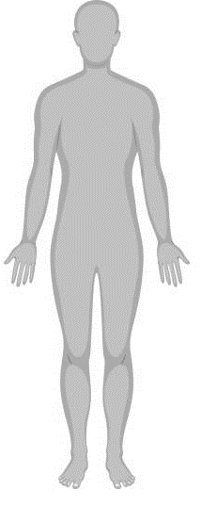
Drivers and Mechanisms of Aging with HIV/ART
Immunosenescence
Mitochondrial
Damage
Epigenetics
Inflamm-aging
Clonal Hematopoiesis/
Stem cell exhaustion
Kennedy et al. Cell 2014
Slide template courtesy of Dr. Leia Novak

Slide 6
Immunosenescence:
Repeated Antigen
Driven
Proliferation
No
Proliferation
Replicative Senescence
(CD28-CD57+)
Clonal
Proliferation
No proliferative potential
telomere length
co-stimulatory molecules (CD28)
diversity of T-cell receptors
anti-viral activity
secrete pro-inflammatory cytokines:
(IL-6, TNF-alpha)
Aging
Effector/
Memory
?
CMV
CMV
Naive
HIV
HIV?

Slide 7
Inflamm-aging:
An increased inflammatory milieu that occurs during aging and results in a low-grade chronic systemic proinflammatory state in the absence of overt infection.
Characterized by variably increased levels of inflammatory mediators such as IL-1, IL-6, IL-18, TNF-alpha, C-reactive protein (CRP), and many others
Baylis et al. Longevity & Healthspan 2013
Howcroft et al. Aging 2013

Slide 8
Contributors to Inflamm-aging:
Chronic activation of the innate immune system
“Damaged macromolecules and cells (self-debris) that accumulate with age due to increased production and/or inadequate elimination.”
Byproducts of the microbiome, best known is the gut microbiome (microbial translocation)
Increased activation of the coagulation system
Cellular senescence
Immunosenescence
(Salvioli et al. Current Pharmaceutical Design, 2013)
(Franceschi and Campisi : J Gerontol A Biol Sci Med Sci 2014)
(Francesch et al. Nature 2018)

Slide 9
Inflammaging and Immunosenescence are linked to diseases of human aging
HIV
?
Inflamm-aging
?
TNF-a
IL-1
CRP
IL-6
IL-18
CMV
Effector/
Memory
Immunosenescence
Frailty
Alzheimer's
osteoporosis
Diabetes
Antibody responses
to vaccines
Cardiovascular
Disease
Mortality

Slide 10
Drivers and Mechanisms of Aging with HIV/ART
ART/PrEP Toxicity
Stress, Trauma, Depression etc.
Immunosenescence
Viral Reservoir
Chronologic Age
Mitochondrial
Damage
Epigenetics
Inflamm-aging
Co-infections
Socio-economics
Clonal Hematopoiesis/
Stem cell exhaustion
Lifestyle
(Diet, Exercise etc.)
Microbiome/gut integrity
Kennedy et al. Cell 2014
Slide template courtesy of Dr. Leia Novak

Slide 11
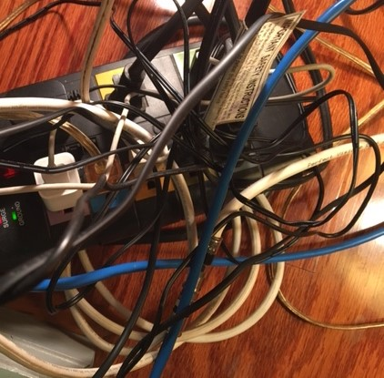
Where do we go from here?
Have we overlooked important drivers/mechanisms?
Which are the most critical drivers/mechanisms to target and how do we target them?
Can we identify overlapping or intercepting pathways to disrupt or are we doomed to address each driver/mechanism separately?
Which are the best models to use to carry out both mechanistic and treatment studies of aging with HIV infection?

Slide 12
General Discussion

Slide 13
Drivers and Consequences of Aging with HIV/ART
ART/PrEP Toxicity
Stress, Trauma, Depression etc.
Immunosenescence
Viral Reservoir
Chronologic Age
Mitochondrial
Damage
Epigenetics
Inflamm-aging
Co-infections
Socio-economics
Clonal Hematopoiesis/
Stem cell exhaustion
Lifestyle
(Diet, Exercise etc.)
Microbiome/gut integrity
Kennedy et al. Cell 2014
Slide template courtesy of Dr. Leia Novak

