Slide 1
Neurobehavioral Complications of HIV in the Modern Treatment Era: Challenges and Priorities for the Future
Epidemiologic/Population Research Group:
For Neurobehavioral Working Group
Igor Grant, MD
Distinguished Professor
Department of Psychiatry
Director, HIV Neurobehavioral Research Program
University of California San Diego

Slide 2
Neurobehavioral Complications of HIV in the Modern Treatment Era: Challenges and Priorities for the Future September 19-20, 2019
Writing Group for the Neurocognitive and Mental Health Priorities
CNS involvement continues to be evident even among PWH who receive best treatments. Reports utilizing multiple ascertainment methods indicate that PWH, compared with HIV uninfected, have CNS involvement evidenced by :
Neurocognitive screening and testing
Neuroimaging: structural; fMRI, DTI, PET, spectroscopy
Indicators of neuroinflammation, including BBB leakage
Indicators of neural injury, and possible processes underlying this, eg., protein mismanagement, mitochondrial injury

Slide 3
Neurobehavioral Complications of HIV in the Modern Treatment Era: Challenges and Priorities for the Future September 19-20, 2019
Writing Group for the Neurocognitive and Mental Health Priorities
Persistence of “neuroHIV” matters
Signals possible CNS reservoir that defies eradication
Damages an important organ – the brain
Results in mood and behavioral changes that are critical to HIV control and eradication
Cognitive difficulties that affect everyday function, adherence, and mortality
Mood [e.g., depression] that affects risk behavior, HIV health, and mortality
Results in decline in personal well-being
Affects public health

Slide 4
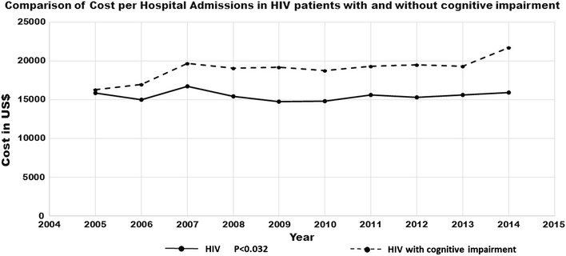
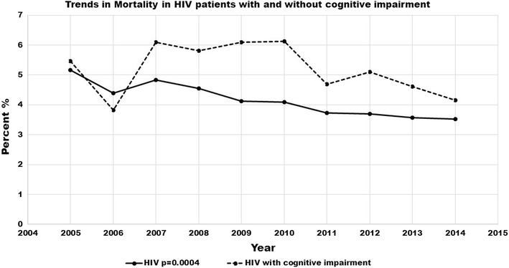
Neurobehavioral Complications of HIV in the Modern Treatment Era: Challenges and Priorities for the Future September 19-20, 2019
PWH with cognitive impairment who are hospitalized have longer, more costly stays, and higher mortality
Patel Set al, AIDS & Behavior 2018

Slide 5
Neurobehavioral Complications of HIV in the Modern Treatment Era: Challenges and Priorities for the Future September 19-20, 2019
Depression negatively impacts HIV care and mortality
Pence BW et al, JAMA Psychiatry 2018

Slide 6
Neurobehavioral Complications of HIV in the Modern Treatment Era: Challenges and Priorities for the Future September 19-20, 2019
Writing Group for the Neurocognitive and Mental Health Priorities
Mechanisms of neuroHIV persistence remain poorly understood
Biologic mechanisms [discussed in Session 3]:
immunopathogenesis;
microbiome;
aging/senescence
Comorbidities
Mood disorders and other psychopathology
Substance abuse
Vulnerability due to prior CNS insults
coinfections

Slide 7
Neurobehavioral Complications of HIV in the Modern Treatment Era: Challenges and Priorities for the Future September 19-20, 2019
Writing Group for the Neurocognitive and Mental Health Priorities
1. What are the incidence and prevalence of neurobehavioral impairment in PWH on cART with and without viral suppression?
2. What is the impact of demographic factors e.g., age, sex, education, race/ethnicity, and socio-economic status on the epidemiology of cognitive impairment and mental health conditions in PWH?
3. What impact do specific comorbidities (e.g., mood disorders, drug addiction, coinfections) have on cognitive and mental health in PWH? Does treatment of such comorbidities improve cognitive function?

Slide 8
Neurobehavioral Complications of HIV in the Modern Treatment Era: Challenges and Priorities for the Future September 19-20, 2019
Writing Group for the Neurocognitive and Mental Health Priorities
4. How can one systematically differentiate between cognitive impairment that is due to the HIV virus or immune suppression from cognitive impairment due to age-related conditions such as cerebrovascular disease or age-related neurodegenerative conditions?
5. How can we delineate phenotypes of HIV associated cognitive impairment that have value in predicting outcomes, and relate to developing specific prevention and intervention strategies?
6. What are the factors that promote neurocognitive health and resiliency among PWH?
7. What are the optimal methods to screen for and confirm cognitive impairment and mental health complications in research and clinical settings for both the United States (US) and resource-limited countries?

Slide 9
Neurobehavioral Complications of HIV in the Modern Treatment Era: Challenges and Priorities for the Future September 19-20, 2019
Writing Group for the Neurocognitive and Mental Health Priorities
8. How do coinfections, including opportunistic coinfections in low- and middle-income countries, influence cognitive and mental health?
9. How does cognitive and mental health affect the behavior of PWH, including medical adherence, self-efficacy, and risk behavior?
10. How can we improve our ability to assess, monitor and intervene on neurocognitive impairment and mental health “in the field” (i.e., outside of clinical and research settings)? What are the opportunities using mobile technology?

Slide 10
Acknowledgements
Thanks to Ned Sacktor for leading the development of this Working Group discussion document.
We all wish you return to health!
Thank you to contributions by Kevin Robertson, Leah Rubin, David Moore, Scott Letendre, Robert Heaton, Ron Ellis, and Cris Achim.

Slide 11
Neurobehavioral Complications of HIV in the Modern Treatment Era: Challenges and Priorities for the Future
Epidemiologic/Population Research Group:
Igor Grant, MD
Distinguished Professor
Department of Psychiatry
Director, HIV Neurobehavioral Research Program
University of California San Diego

