Slide 1
Aging with HIV in the US / Proposed Research Implementation Study:
clinical & community care & services needs, unmet needs
Jules Levin
Executive Director, founder NATAP, National AIDS Treatment Advocacy Project
www.natap.org

Slide 2
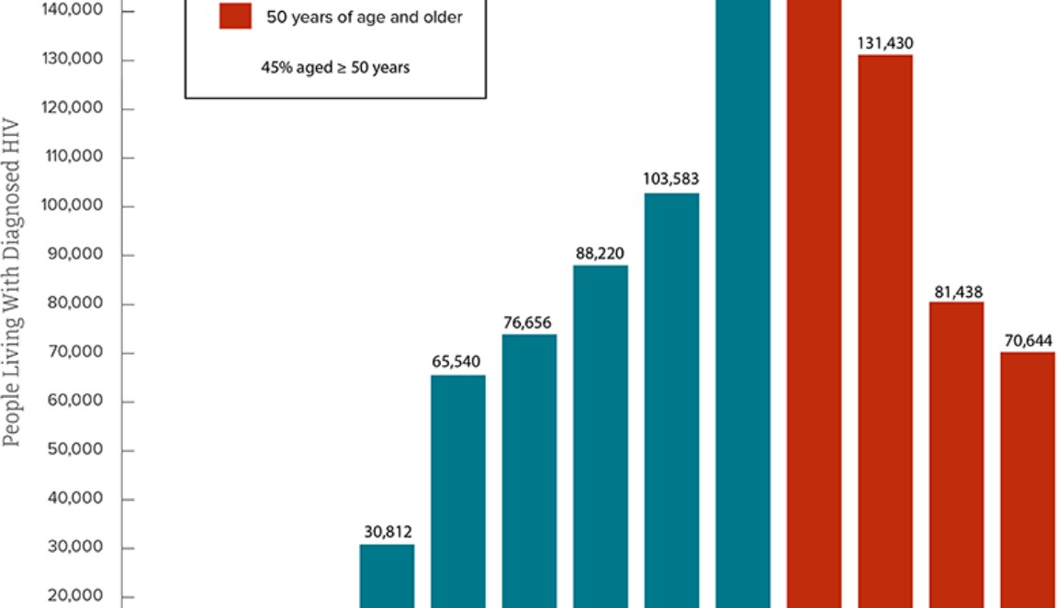
Epidemiology – (1) 70% over 45; (2)
150,000 over 60; (3) 70,000 over 65

Slide 3
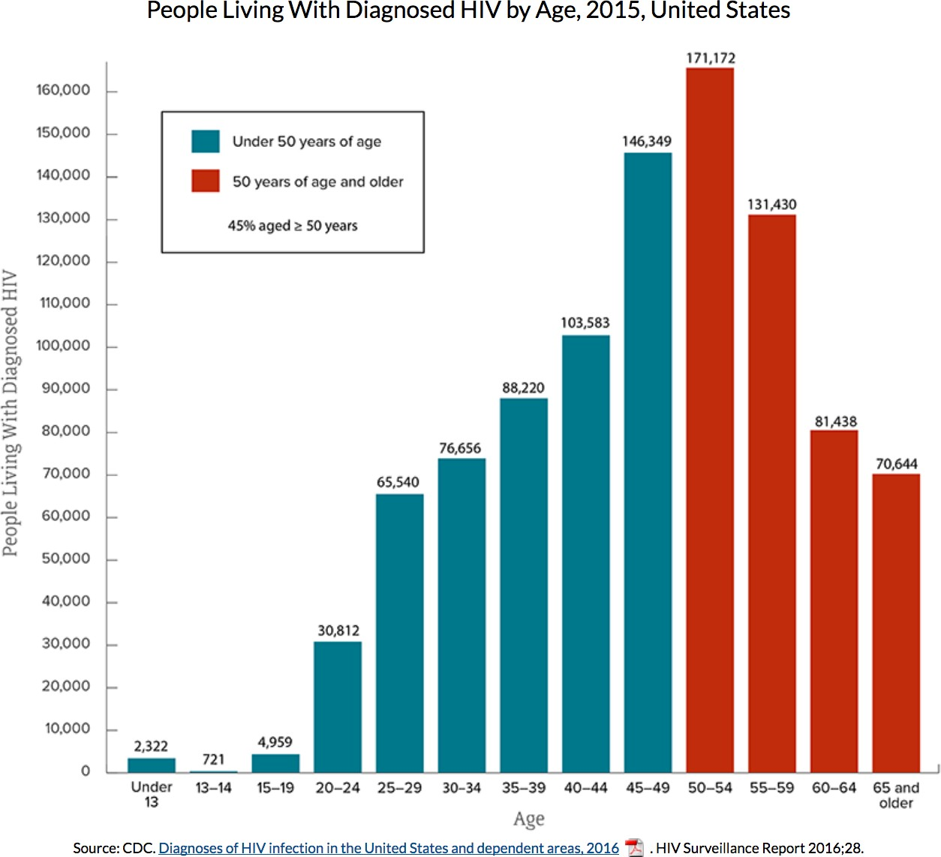

Slide 4
Aging Concerns
CDC Report in 2015: 150,000 over 60 years old.
by 2030 75% > 50 years age: 85% will have CVD; 30% malignancy; 25% diabetes
Mean age of HIV+ increase from 45 to 55
Average cost of NCD care will double or more for some for older PLWH due to comorbidities & be 50% of healthcare costs for >50

Slide 5
only study finding increasing death rates due to comorbidities. ATHENA Cohort Glasgow 2018
Despite recommended ART immediately 50 – 60% NOT virally suppressed.
immune activation persists despite long term viral suppression & CD4 poor response persists despite viral suppression.

Slide 6
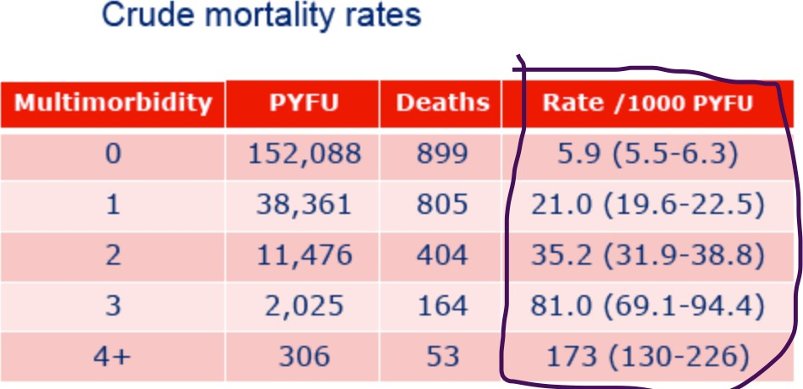
Multimorbidity Increases Death Rates –
30% >70 have 3-4+ comorbidities.
HIV+ Women have higher multi-comorbidity rates at younger ages than men. Death rates higher in women. Menopause?

Slide 7
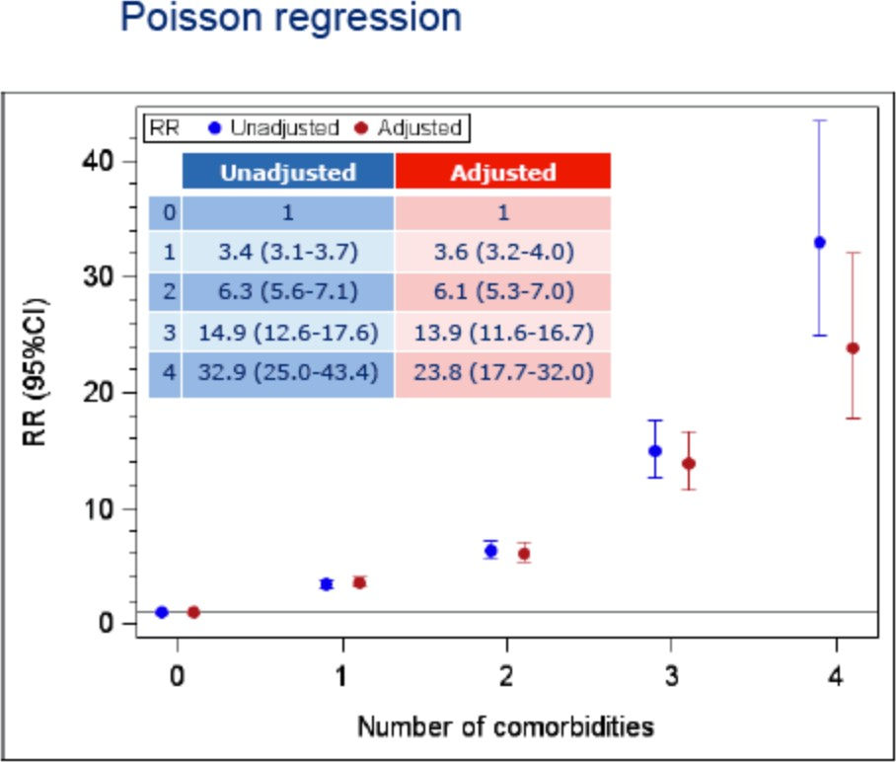
Adjusted Death Rates Increase

Slide 8
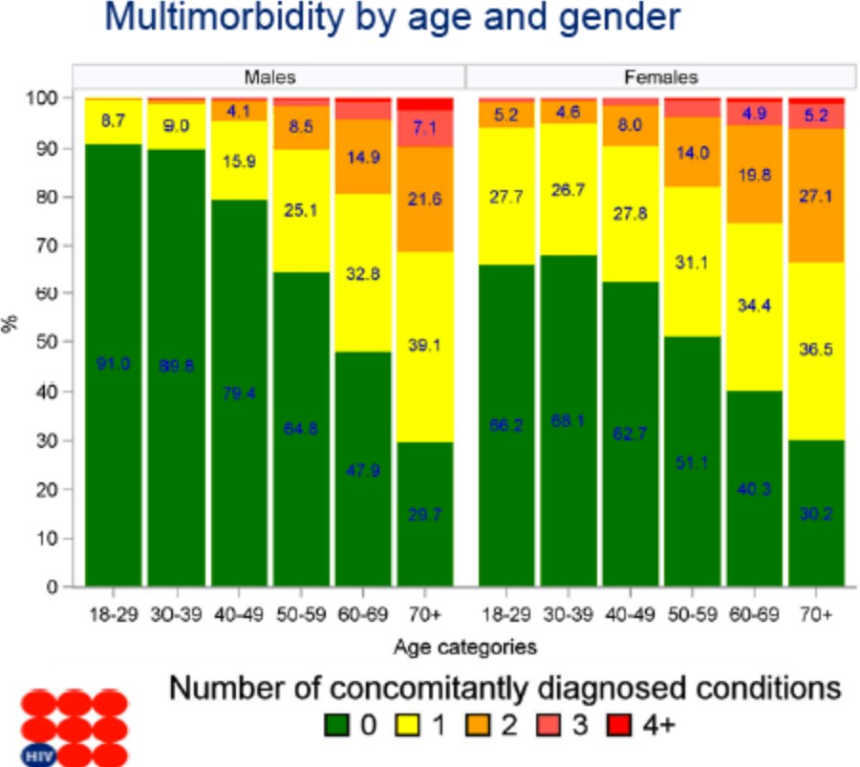
Women
Women fare worse

Slide 9
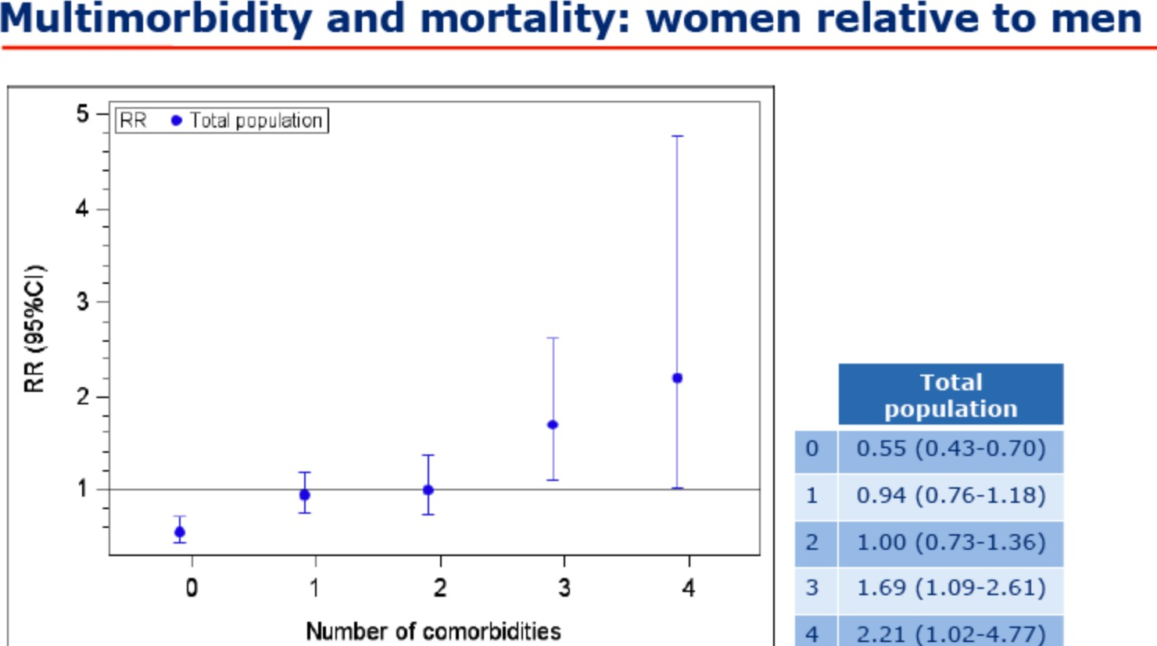

Slide 10
Older Patient Concerns & Needs in Clinic Now
Care & Services
Mental Disability Health Services & Substance Abuse: In NYC/Mt Sinai “most older HIV+ have some degree of cognitive impairment” Yet Mental Health Services provision/ insurance is spotty.
Physical disability
STIGMA, self-stigma - all these rise to New Levels in older 65+. is MUCH greater in 60+: self-stigma, blame, abandonment by all including healthcare, advocates, govt officials
Navigating healthcare system. unable to get to medical visit- wait months for appointments
Healthcare literacy, access, understanding lacking in all despite education level
Cognitive impairment
  Frailty
  Gait/walking Impairments
  Osteoporosis, falls, fractures Increase – disability & mortality increased
  homebound
  mentally & physically challenged, impaired, disabled
  unable to perform normal daily activities
  socially isolated, lonely

Slide 11
Older/Aged Patient Concerns
PHYSICAL DISABILITY / Unable to Perform Normal Daily Activities:
Fatigue, low energy (mitochondria damage?)
Neuropathy, pain, opioid use
Fatty liver ignored
Unable to pay bills (evicted),
shop for food
Anxiety ridden, scared
- feel abandoned
- depressed
Deprescribing POLYPHARMACY, ADHERENCE: what is adherence level in older HIV+ >65 with multicomorbidities ?
Cancers

Slide 12
New Care Model Needed
Despite RWCA services many are NOT getting needs met.
We need to structure Care in the clinic and community in the USA to meet the changing needs of the HIV patient population in care who are aging

Slide 13
Implementation Study Proposed
Study would provide added components of care & services and evaluate if there is improvement over time in QOL:
Evaluate New Care Model
Does IT, telemedicine & other care/service components provided through this study improve outcomes QOL, compliance, adherence
New Care Model
Longer visit time with doctor: NY from 20 to 40 minutes;
reimbursement capacity needed for doctor/clinic
Geriatric care in clinic
IT/telemedicine visits to patients; aging IT social networking
Home monitoring: viits, telemedicine
Insufficient care coordination - Better communications between PCP, specialist & PLWH
Dedicated aging nurses, staff with low case load
Education for older PLWH regarding their conditions: prevention, care, treatment
Include CAB with PLWH >60 who represent this group “suffering” with needs, unmet needs
Monitor, collect data & evaluate impact of substance abuse

Slide 14
Research Questions / Needs
Real-Time Data Collection & reporting, Answers in 1 year:
Research Question Examples:
Bone. Fosamax follow-up; how many have fractures; what are Vit D levels-associations with ART; post fracture data; how many are homebound, unable to function; what services are needed; difficulty making doctor visits & understanding health & comorbidities
daily living activities: how are they impacted by frailty, disability, mental health impairment. Identify &quantify on large cohort scale precise activities HIV+ are unable to perform (e.g. food shopping, preparation, home maintenance, pay bills, social isolation)
Geriatric Care Component in each clinic site in study. Geriatric Clinics: 4 in US –Cornell, UCSF, Mass Gen.
Brain function. Identify & quantify brain & cognitive function over time to assess if accelerated/progressed in sub-populations.
Substance Abuse: quantify/monitor, interventions, outcomes, adherence, death/suicide
Social isolation. Implement & evaluate programs like online group, nurse IT monitoring, home visit evaluations.
Home Maintenance. Can we provide service that improves home maintenance.

Slide 15
National Implementation Study Cohort
Cohort, could be fostered within MACS & WIHS, and perhaps joining all together with other cohorts.
Real Time Collection & Reporting: we cannot wait 5 years for results. We need to design collection & reporting methods for 1 year.
Update case reports with required new information on depression, social isolation, etc
CAB representative of this population.

Slide 16
Scientific Research Questions: What is Causing Comorbidity Onset
Premature, accentuated, accelerated
We are getting morbidities sooner, at earlier age, in greater numbers
WHY – what is underlying cause - for each organ: kidney, CVD, brain, bones, cancers
Immunosenesence
Studies show immunosenescence onset soon after Infection
Inflammation
HIV contribution, lifestyle, behavior
2 GREATEST Research QUESTIoNS: brain & cognitive impairment
WHY? – frailty-muscle/sarcopenia, gait/mitochondria disabilites ?

