Slide 1
ACTION Meeting
Steven Deeks, MD Professor of Medicine
Division of HIV, Infectious Diseases, and Global Medicine
Zuckerberg San Francisco General
University of California, San Francisco

Slide 2
ACTION Meeting
Fauci: ART is one of the greatest advances of modern medicine, but problems persist, and these are due to poorly defined characteristics, including immune activation
Althoff
Multiple generations of epidemics emerging, each with unique risk factors
Life span is normal but health span is the real goal
All: Limited capacity of health care system to care for aging PLWH, particularly with multimorbidity

Slide 3
Does HIV infection and/or ART cause excess co-morbidities and if so are these due to standard or distinct mechanisms?
Does HIV and/or ART accelerate or the process of aging?
Can this information be useful?

Slide 4
ACTION Meeting: Epidemiology
What is the question?
Do we want to compare aging with and without HIV?
Is this even possible (metrics need to be equally valid in both groups)?
Key future objective: Find the common pathways for multi-morbidity, ideally one that is shared and contributes to the disease process in a meaningful manner
Key limitations: lack of definition of phenotypes needed (physiologic, molecular)
Machine learning of emerging large databases may help
Need better ways to measure resilience/pre-fraility (frailty is rare)
Nee informative biomarker that will predict morbidity and mortality

Slide 5
Neurobehavioral Complications Key Challenges and Priorities for the Future
What are the incidence and prevalence of neurobehavioral impairment in PWH on ART?
How can one systematically differentiate between cognitive impairment that is due to the HIV or immune dysfunction from cognitive impairment due to age-related conditions such as cerebrovascular disease or age-related neurodegenerative conditions?
What are the factors that promote neurocognitive health and resiliency among PWH?
What are the optimal methods to screen for and confirm these syndromes?
How does cognitive and mental health affect the behavior of PWH, including medical adherence, self-efficacy, and risk behavior?

Slide 6
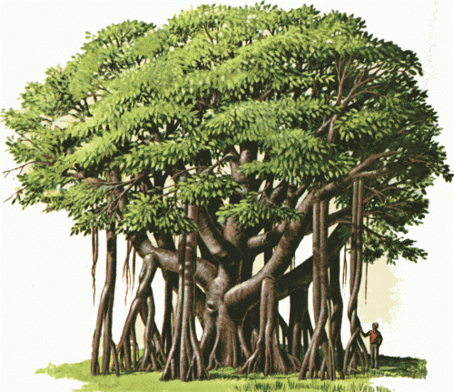
Basic Science: Where best to intervene in treated HIV?
Or is the tree a Banyan?
Justice et al, JID, 2018

Slide 7
Where best to intervene in treated HIV?
Do all “root drivers” contribute equally?
Health-related behavior
ART toxicity
Do some inflammatory “branches” drive some diseases more than others?
Which are truly causal?
Will intervening on some inflammatory pathways have adverse consequences (infections, cancer, etc.)?
Can systems biology approaches help us prioritize interventions?
Novel inflammatory indices / imaging to risk stratify and monitor Rx response?

Slide 8
Basic science Microbiome/virome/ fungome and metabolome
Does the microbiome (bacterial, viral, fungal) play a causal or contributory role in HIV comorbidities?
How do other cofactors interact with HIV infection to affect the microbiome and downstream comorbidities?
What are the mechanisms of host/HIV/microbiome interactions?
If causal or contributory - rather than just a consequence/association - can the microbiome in HIV be manipulated to modify these pathways?

Slide 9
ACTION Meeting: Clinical Science
Comorbidity prevention and management: Should it be the same as the general population or tailored?
Prevention studies (including screening and interventions) across the lifespan aimed at reducing comorbidity burden
Incorporating patient-centered input and outcomes (symptom management including for pain), as well as innovative imaging and biomarker outcomes as surrogates, in clinical trials.

Slide 10
ACTION Meeting: Clinical Science
Clinical trials: creative designs with multiple endpoints needed with programs supported by multiple institutes (MACS/WIHS model)
Do we need dedicated studies of co-morbidities or do we need to include people of HIV into studies of co-morbidities
Comorbiditiy “gradients”: how do we prioritize what to treat
Can this be informed by non-biased, machine learning approaches using “big data”?
New models for clinical care needed (geriatricians)

Slide 11
ACTION Meeting: Implementation
Discussion was highly theoretical and aimed at establishing definitions, setting stage for today’s meeting theoretical with discussions on background, definitions
Need for more training programs

Slide 12
ACTION Meeting: Implementation
Is there a need to add implementation science to efficacy trials? Will this accelerate uptake and enhancement?
How can implementation science approaches be leveraged to concurrently complement and augment the findings of trials like REPRIEVE
How can NIH cohorts (MACS/WIHS, CNICS, IdEA) be leveraged to conduct implementation studies?
What scientific questions related to co-morbidities are better addressed via “natural experiments” utilizing implementation science?

Slide 13
Implementation Sciences: Key Questions
What combination of implementation strategies are necessary and sufficient to increase the impact of interventions for HIV-related comorbidities?
How can we learn from our successes and challenges as we roll out interventions for HIV-related comorbidities?
Can the cost and resources involved in a successful multicomponent implementation strategy package be reduced while maintaining its impact?
How can the field begin to optimize implementation during the development and testing of new interventions for HIV-related comorbidities?

Slide 14
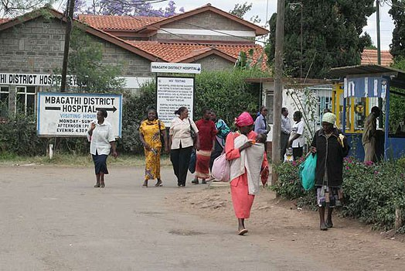
ACTION Meeting: Syndemics
Local context matters
Social determinants (including stigma) affect health
Ester: most of her problems are socioeconomic; what do we need to do with this story, do we need to quantify why, should we be intervening on one, can we really as a biomedical group fix most of what affects Ester’s problem

Slide 15
ACTION Meeting: General
Need more patient-centered approaches
Community input was strong, as was description of specific cases (Esther) Audience participation
Social determinants will need to be fully quantified and integrated in larger cohorts and clinical trials
The study of healthy aging will require multi-disciplinary teams
Need more synergy between social and biomedical sciences
Disease specialists (NIH institutes)
Anthropologists, social scientists, behavioral scientist
Critical need to include people with HIV in non-HIV studies

Slide 16
ACTION Meeting: General
By definition our approach yesterday was very ambitious and general
Breakout sessions: visit the priorities; come back with concrete suggestions to the extended group to ask for further comment
We need more direction as to what needs to be studied and how it should be studied for the consensus discussion and ultimately to disseminate the group’s work

