Slide 1
Pathogenesis – Basic Science

Slide 2
NIH Workshop on HIV-Associated Comorbidities, Coinfections and Complications: Immunopathogenesis
Peter W. Hunt, MD: University of California San Francisco
FOR
Tricia Burdo, PhD: Temple University
Nicholas Funderberg, PhD: Ohio State University
Michael Lederman, MD: Case Western Reserve University
Ivona Pandrea, MD, PhD: University of Pittsburgh

Slide 3
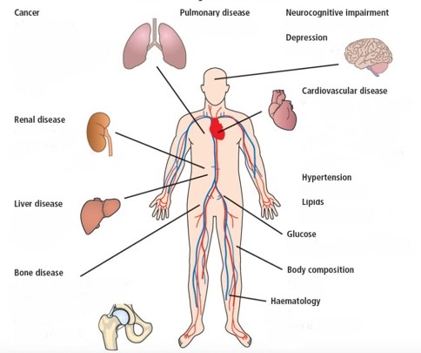
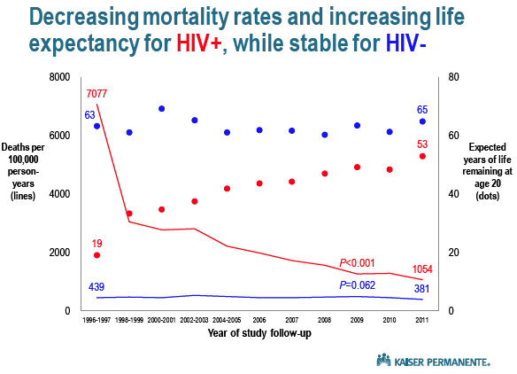
Persistent ↑ Morbidity / Mortality in Treated HIV
Mortality Rates (⎯)and Life Expectancy (●)
↑Multi-Morbidity
HIV+ vs. HIV-
Deaths per 100,000 person-yrs
Est. Yrs of Life Remaining
Marcus et al, JAIDS, 2016
Adapted from: Aguilar et al, Key Opinions in Med, 2016

Slide 4
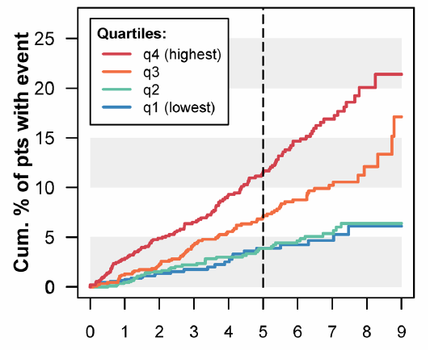
Persistent Inflammation Predicts Morbidity & Mortality in Treated HIV
IL-6 / D-dimer Score predicts Non-AIDS Events
(SMART)
Inflammation predicts individual morbidities
Mortality (Kuller, PLoS Med, ‘08; Tien, JAIDS, ‘10; Justice, CID ‘12; Hunt, JID ‘14)
Cardiovascular Disease (Duprez, Atherosclerosis, 2009)
Cancer (Breen, Cancer Epi Bio Prev, 2010; Borges, AIDS, 2013)
Venous Thromboembolism (Musselwhite, AIDS, 2011)
Type 2 Diabetes (Brown, Diabetes Care, 2010)
COPD (Attia, Chest, 2014)
Renal Disease (Gupta, HIV Med, 2015)
Bacterial Pneumonia (Bjerk, PLoS One, 2014)
Cognitive Dysfunction (Burdo, AIDS, 2013; Letendre CROI 2012)
Depression (Martinez, JAIDS, 2014)
Frailty (Erlandson, JID, 2013)
Years
Grund, PLoS One, 2016

Slide 5
Inflammation Causes Chronic Disease in HIV-
Canakinumab (IL-1b inhibitor) ↓CAD Events
Canakinumab ↓ Cancer Deaths
Cumulative Incidence (%)
Cumulative Incidence (%)
Years
Years
Ridker, NEJM, 2017
Ridker, Lancet , 2017

Slide 6
Where best to intervene in treated HIV?
Or is the tree a Banyan?
Justice et al, JID, 2018

Slide 7
Where best to intervene in treated HIV?
Do all “root drivers” contribute equally?
Role of HRBs (drugs, smoking…)?
Role of ARVs themselves?
Do some inflammatory “branches” drive some diseases more than others?
Which are truly causal?
Will intervening on some inflammatory pathways have adverse consequences (infections, cancer, etc.)?
Or exacerbate some of the root drivers?
Can systems biology approaches help us prioritize interventions?
Can we improve our understanding of system from clinical trials, animal models?
Novel inflammatory indices / imaging to risk stratify and monitor Rx response?

Slide 8
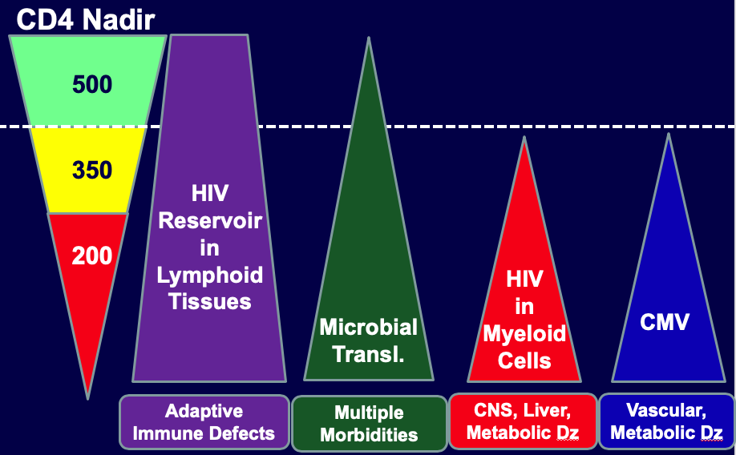
Need for tailored approach to ↓inflammation?
Root drivers may differ in anatomic distribution
and activity at earlier disease stages
Some – but not all – morbidities persist in individuals who start ART early
Infections, infection-related cancer
Sex differences (Meier, Nat Med, 2010; Scully, JID, 2019)
Hormonal effects in TG populations?
Geographic differences
Viral and host genetics, prevalent co-infections (helminthes), diet, etc.
Differences need to be considered in clinical and animal model studies
Hunt, Lee, Siedner, JID, 2016

Slide 9
Open Discussion

